Slide 1
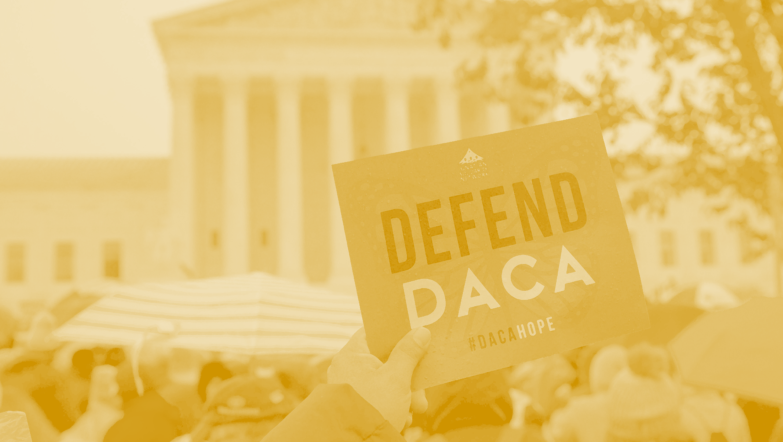
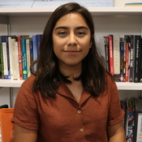
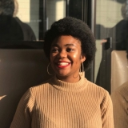
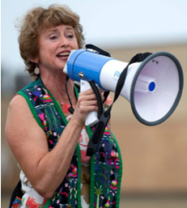
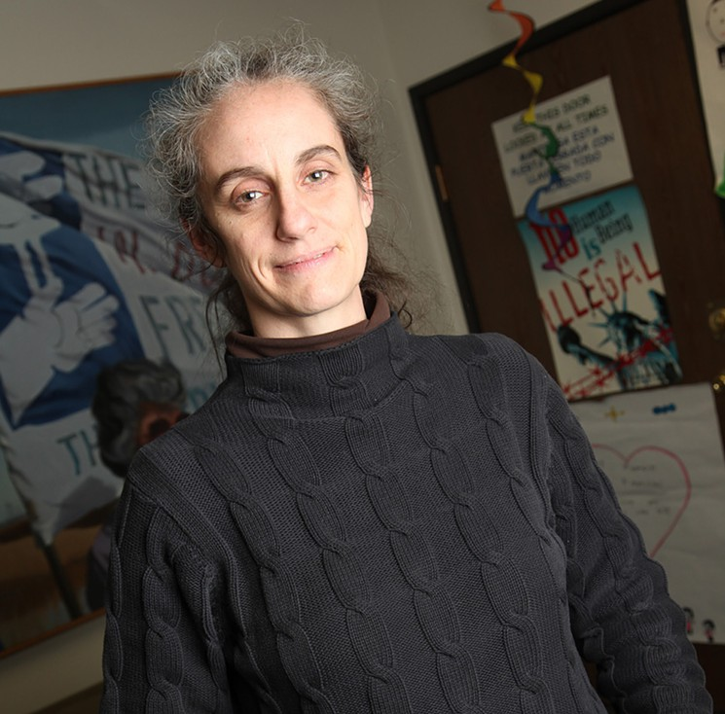
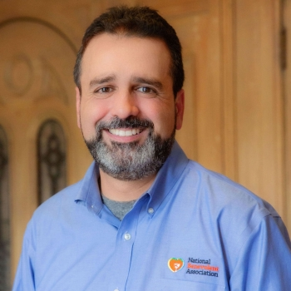
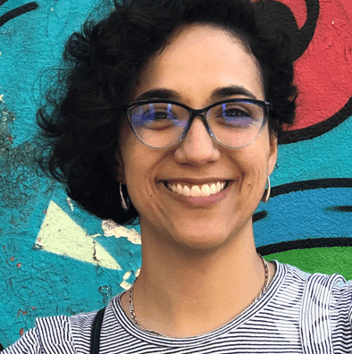
#FAITH4DACA WEBINAR
Giovana Oaxaca, NETWORK Lobby
Sanaa Abrar,
United We Dream
Peniel Ibe,
American Friends Service Commitee
Rev. Sharon Stanley-Rea,
Disciples of Christ
Jennifer Piper,
AFSC Colorado
Rev. Héctor Hernández Disciples of Christ
National Benevolent Association
Rev. Bere Gil Soto, Disciples of Christ

Slide 2
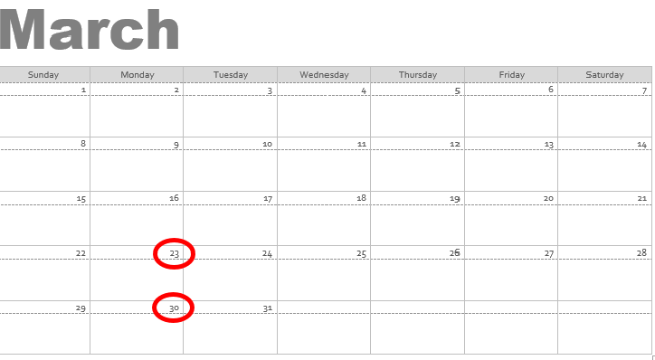
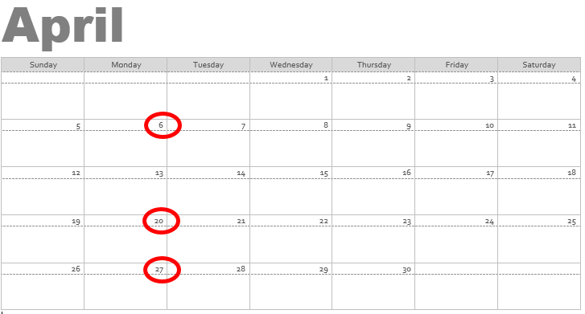
Current State of Play
Expecting a decision between now and the end of April
Monitoring Different Decision Dates
New COVID-19 Reality

Slide 3
DACA Decision Day
10-10:30 AM ET: Potential decision
1 PM ET: Press Call
7 PM ET: Community Call for Directly Impacted Individuals
Next day, 1 PM ET: Virtual Rally for Directly Impacted & Allies

Slide 4
For Directly Impacted Communities - Evening Webinar Day of Decision

Slide 5
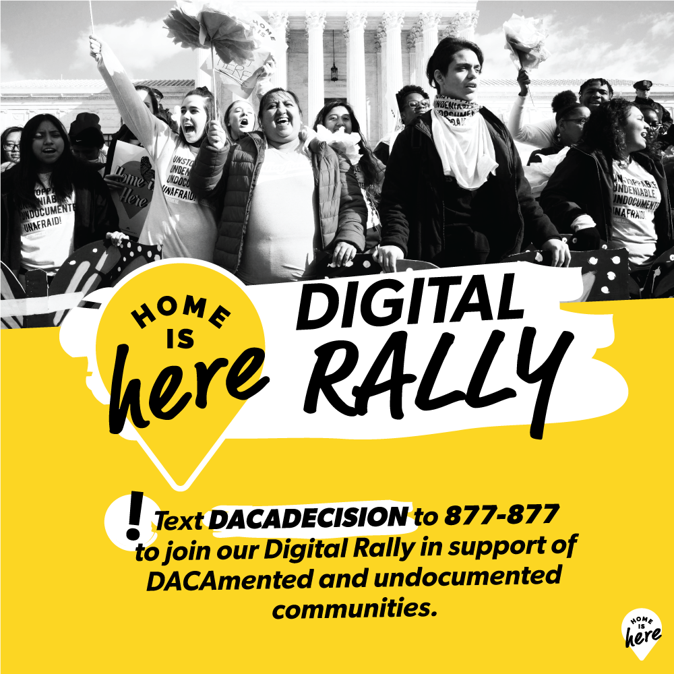
Join Our Virtual Rally the Day After a Decision!

Slide 6
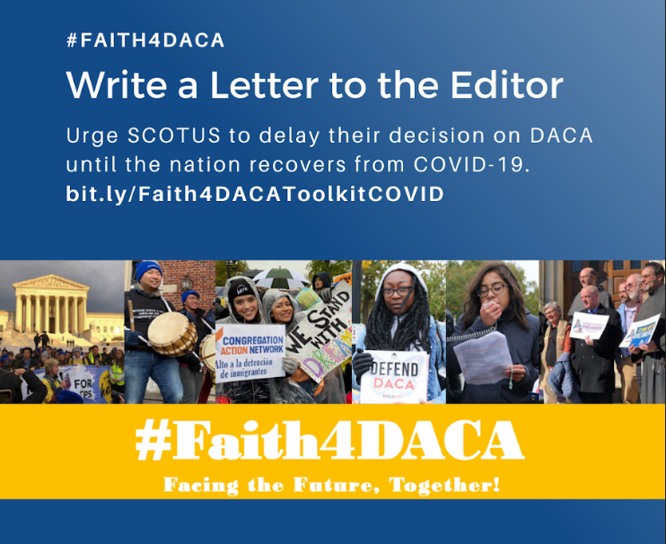
Take Action Now!
Actions YOU Can Take Now to Support a Court Delay
Publicly Urge Scotus To Stand With DACA Recipients And Delay
-A critical time for Letters to the Editor!
https://bit.ly/Faith4DACAToolkitCOVID
Prepare A Statement Of Solidarity/ Press Release To Be Issued When A Decision Is Made

Slide 7
Take Action Now!
Actions YOU Can Take Before and After a Decision
Dedicate Prayer, Testimony Or A Message At Your Faith Community
Organize/Join A Virtual Vigil Or Rally To Support DACA Recipients And Undocumented Youth
Engage On Social Media With #Faith4DACA and #Homeishere
Write An Opinion Editorial Or Letter To The Editor For Your Local Newspaper
Connect With Your Elected Officials
See the Faith4DACA SCOTUS Toolkit for more information!

Slide 8
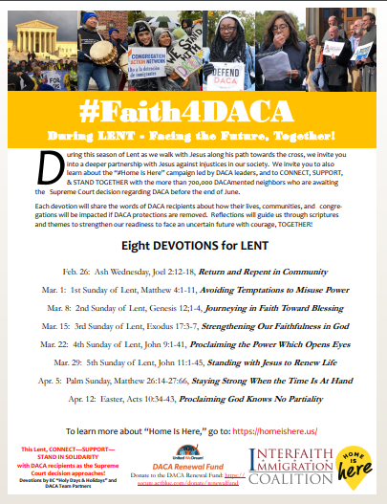
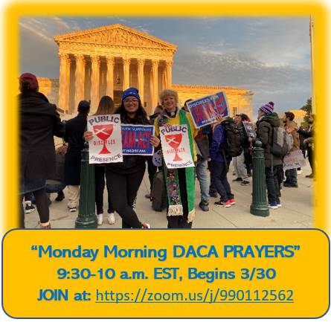
Take Action Now!
Dedicate Prayer, Testimony Or A Message At Your Faith Community
Organize/Join A Virtual Vigil Or Rally To Support DACA Recipients And Undocumented Youth

Slide 9
Take Action Now!
Promoting the Virtual Prayer Chain
1. Record a video of yourself holding a printed, filled out #Faith4DACA page
Say: My name is _________________ and I’m ______________ (faith tradition)
I am from ___________________ (city, state)
I pray with DACA recipients because_______________________
2. Upload your video to Twitter with the hashtag #Faith4DACA and tag the Interfaith Immigration Coalition (@interfaithimm) and tweet at your members of Congress.
3. Post the video to Instagram and Facebook with #Faith4DACA. Make the post public on Facebook and tag Interfaith Immigration Coalition and your members of Congress!
Engage On Social Media With #Faith4DACA and #Homeishere

Slide 10
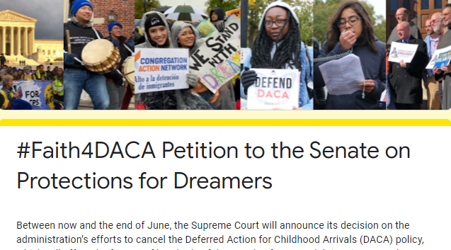
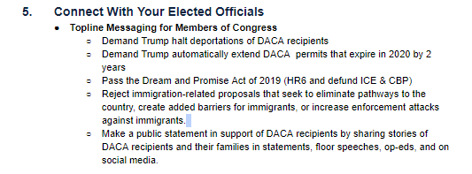
Take Action Now!

Slide 11
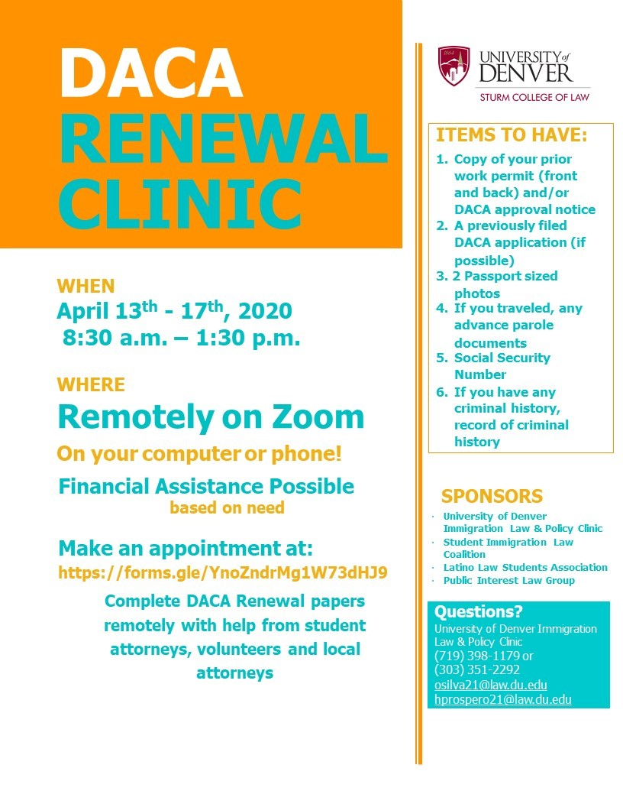
Community Action

Slide 12
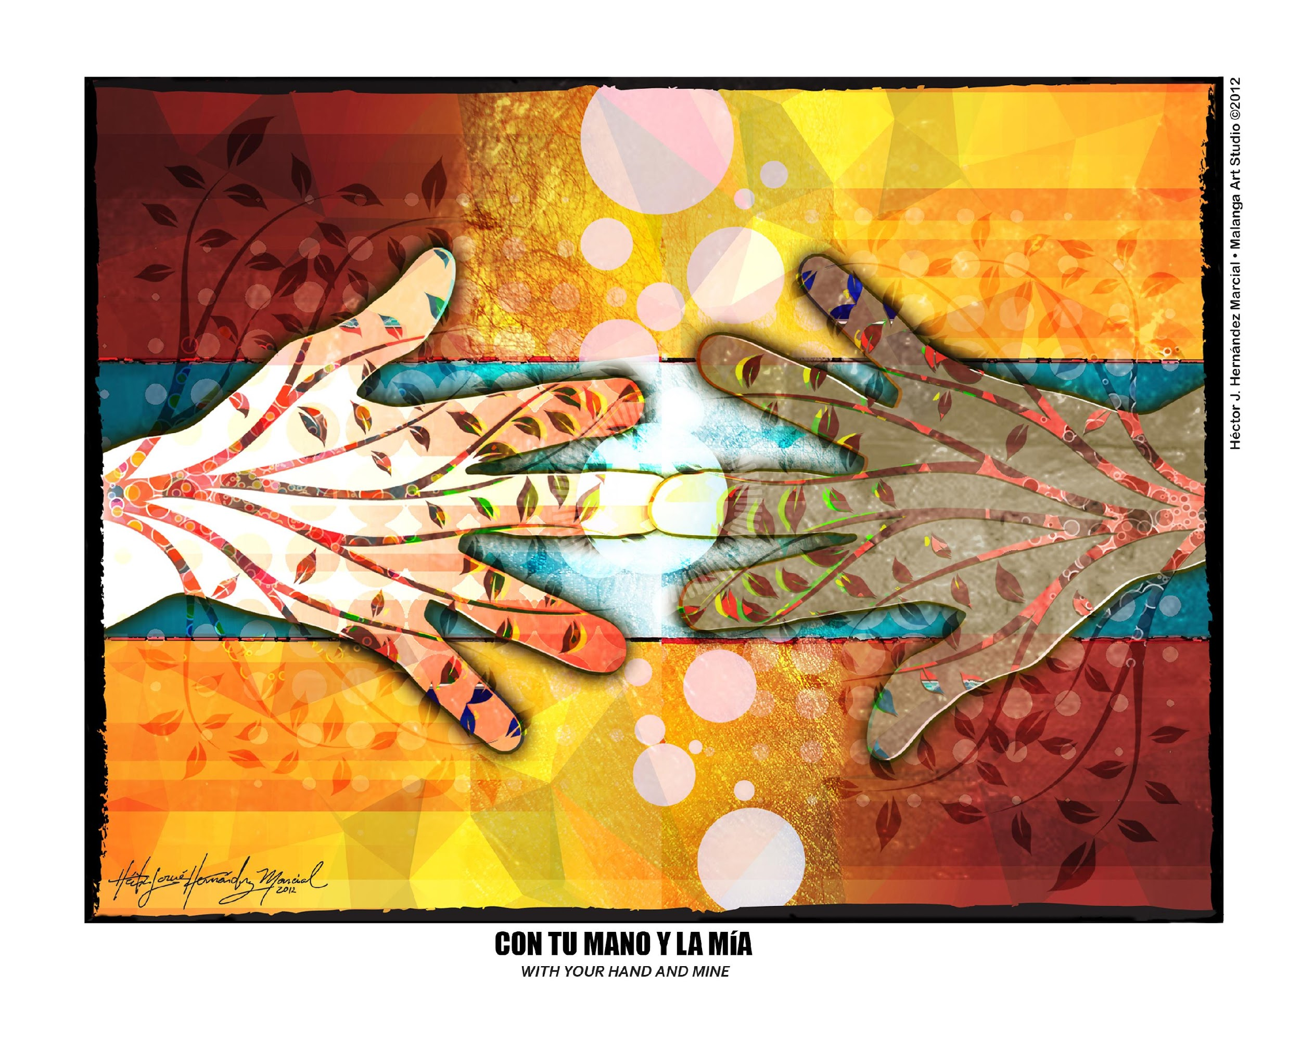
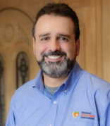
Mental & Spiritual Grounding
Rev. Héctor J. Hernández, M.Div.,MAMFT
Connect Coordinator / Coordinador de Enlaces
Mental Health and Wellness Initiative
Rev. Bere Gil Soto, M.Div.,MAMFT
Pastora iglesia Hermandad Cristiana
www.NBAcares.org

Slide 13
Supreme Court’s announcement on Deferred Action for Childhood Arrival (DACA) program.
Let's understand the outcome of this decision as :
﻿Humancaused intentional disaster*
“When disasters arrived, it means the end of normalcy”
"The loss of normal swallows us all."
-Brene Brown
* Disaster Spiritual Care, 2nd Edition: Practical Clergy Responses to Community, Regional and National Tragedy (p. xvii). Turner Publishing Company. Kindle Edition.
Notes:
One way to see this decision is as a disaster event.
And the goals of such intentional acts are to create terror, foster panic and chaos, and disrupt daily functioning.
The American Red Cross defines a disaster as “an event of such destructive magnitude and force as to dislocate, injure or kill people, separate family members, and damage or destroy homes.”
“A disaster at its most basic level is an event that severely disrupts the everyday lives of individuals and communities. It almost always involves the loss of life and/or extreme, widespread property damage.”
- "The state of being normal or usual; normalcy."

Slide 14
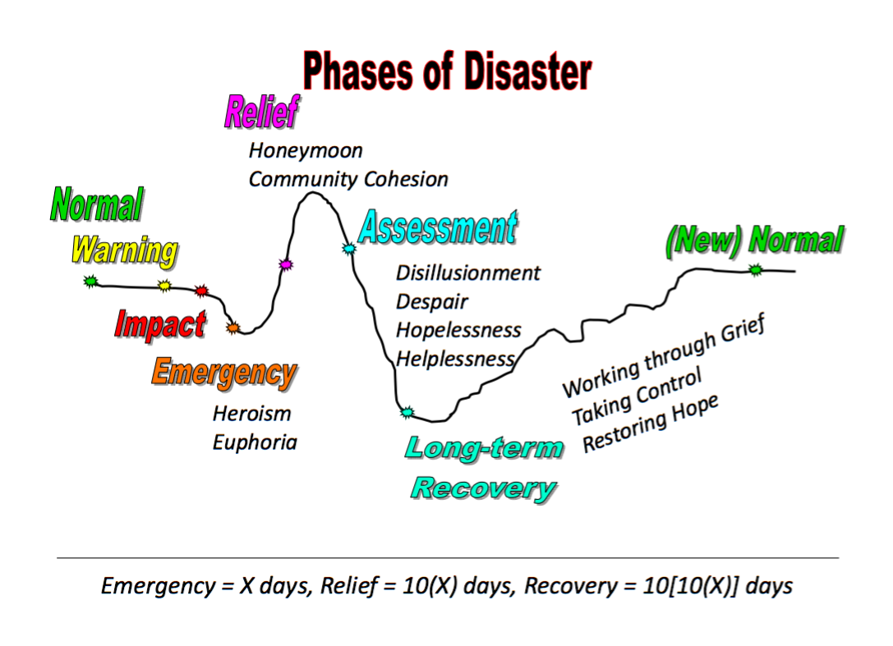
* Disaster Spiritual Care, 2nd Edition: Practical Clergy Responses to Community, Regional and National Tragedy (p. xvii). Turner Publishing Company. Kindle Edition.
Notes:
“A disaster at its most basic level is an event that severely disrupts the everyday lives of individuals and communities. It almost always involves the loss of life and/or extreme, widespread property damage.”
Further, disasters often overwhelm ﻿the initial coping capacities and resources of an individual, a family, or a community. Disaster disruptions can be spiritual, emotional, economic, physical, and ecological. The larger the disaster, the more likely it is that a community will need outside assistance with recovery and healing, both short- and long-term.

Slide 15
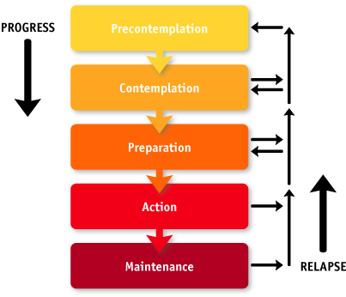
This type of events (disaster) is not one that follows natural rhythms of things; this will take time to:
Assimilate the scope of this event
Process the repercussions, losses, and overall consequences
Move to a position to imagine (contemplation), some actions (possible plan).
Begin to act according to the plan
Adapt the plan (embrace the process)
We need to be able to “create a new normal and grief the loss of normal at the same time." - Brene Brown
Notes:
"Adrenaline surges during the onset of a crisis, but eventually fades away Further, disasters often overwhelm the initial coping capacities and resources of an individual, a family, or a community. Disaster disruptions can be spiritual, emotional, economic, physical, and ecological. The larger the disaster, the more likely it is that a community will need outside assistance with recovery and healing, both short- and long-term.

Slide 16
When disaster strikes people will be traumatized; their spirits will require healing.
﻿Our responsibility as leaders of faith communities is to be agents for God in taking care of God’s flock.
It is first our responsibility to help our communities prepare.
Then we must guide them to appropriate reactions when a threat occurs.
Disaster Spiritual Care, 2nd Edition: Practical Clergy Responses to Community, Regional and National Tragedy (p. 26). Turner Publishing Company. Kindle Edition.

Slide 17
The Role of Spiritual Leaders
Rev. Bere Gil Soto, M.Div.,MAMFT
Pastora iglesia Hermandad Cristiana
Naming the obvious: we are more than preachers/teachers.
“Commit to… Participating responsibly in the life and work of my community, bearing prophetic witness to the Gospel of Jesus Christ, and working toward a just and morally responsible society.” (Ministerial Code of Ethics, CCDOC)

Slide 18
The Role of Spiritual Leaders
What God are we sharing with others? From Christian perspective, God:
Creates & recreates
Empowers
Listens
Liberates
Judges against injustices and evil
Loves & embraces
Joins us in life

Slide 19
The Role of Spiritual Leaders
As spiritual leaders of communities of people pushed to the margins, we are called first and foremost to do ministry of presence
The importance of empathy amid suffering.

Slide 20
Digital Art by: Mary Button, marybutton.com
“In the broken body of Jesus on the cross, Latino/a Christians see their own experience of brokenness… assured that God-in-Christ understands the Latino/a struggle and yearning for abundant and real life.”
Zaida Maldonado Pérez

Slide 21
Concrete Strategies & Resources for individuals, leaders and communities
Acknowledge
Validate, Empower, Encourage, Comfort
2. Educate
Educate ourselves and our congregations
3. Refer
If you feel in over your head… you are. Work in alliance with a mental health provider(s). Have the whole community of faith to support our DACA siblings and their families.

Slide 22
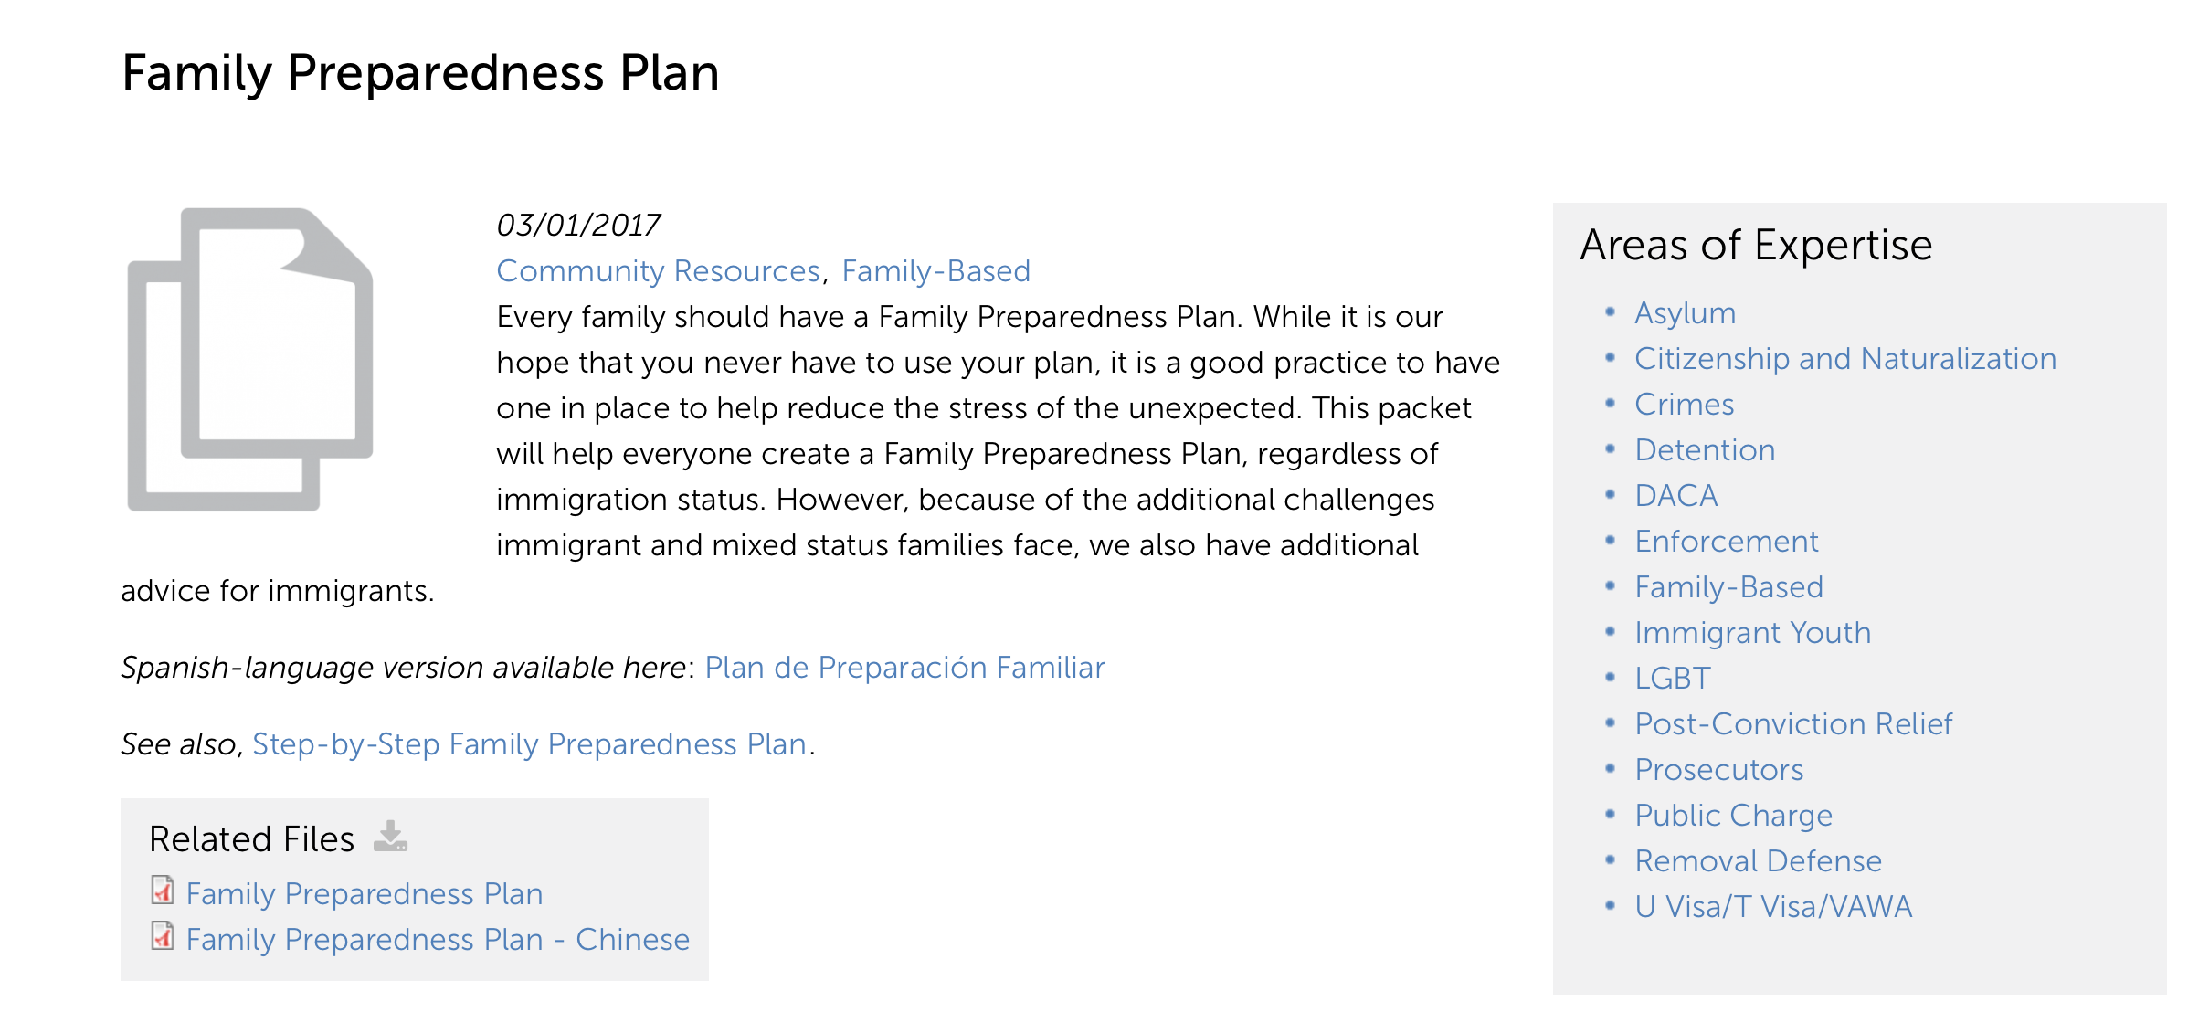
Strategies & Resources
Create a family preparedness plan to ensure you have some control in time of emergency see
https://www.ilrc.org/family-preparedness-plan
Notes:
Some resources shared by my friend Rev. Dr. Sharon Stanley-Rea who is
is Director of Refugee & Immigration Ministries (RIM) for the Christian Church (Disciples of Christ).

Slide 23
Strategies & Resources
We must pay attention (be aware) of signs and symptoms of depression and anxiety related to the fears associated with raids, deportation threats, and an uncertain future.
• Mental Health Tool-Kit: https://unitedwedream.org/2017/10/mental-health-toolkit/
Notes:
About the Toolkit
The UndocuHealth Project Emergency Toolkit was designed to alleviate not only the stress and anxiety of folks across the nation and keep ours families secure, but also to give the reader tools that will allow them to conduct safe zone events and incorporate stress reducing activities within their community work and daily lives.
The first section titled The Seven Steps to Keep Calm & Continue Organizing is designed to give you a step by step process in how to set up a safe zone for your community and how to follow up with simple healing events.
The 101 Mindfulness Breathing section is for you to explore the power of breathing through meditation and use it in your group before and after organizing such as events and/or meetings.
Under Mental Health Resources you will find a list of online resources that address. Under Fight or Flight vs Rest and Digest you will find the correlations between trauma and the physical effects of stress.

Slide 24
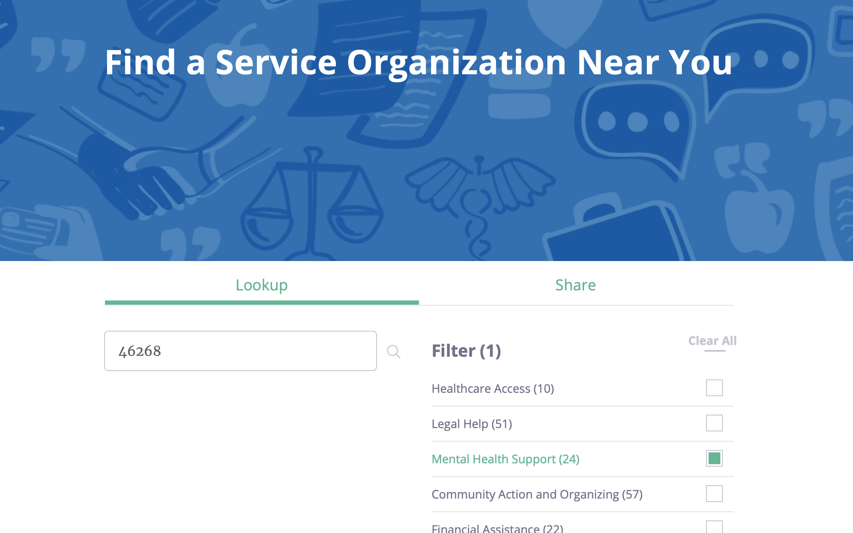
Strategies & Resources
If you, or someone you know, is looking for local support, to find organizations that work with immigrants and provide healthcare and mental health services near you.
https://www.informedimmigrant.com/service-organization-search/#

Slide 25
Strategies & Resources
For immediate help, 24/7: National Suicide Prevention Lifeline, 1-800-273-TALK, or Crisis Text Line by texting TALK to 741741.
To find a therapist near you, see the Psychology Today Therapy Directory.
https://www.psychologytoday.com/us/basics/suicide
https://suicidepreventionlifeline.org

Slide 26
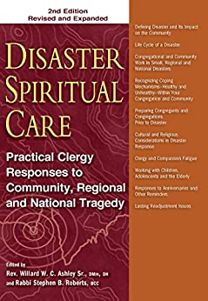
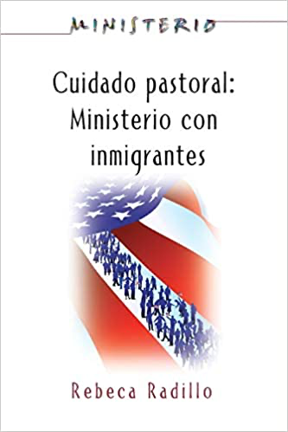
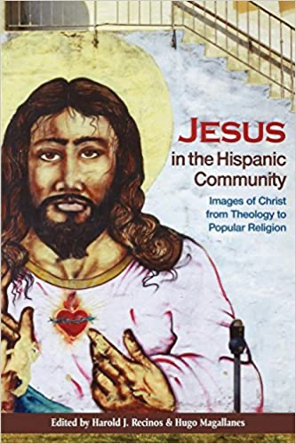
Strategies & Resources
Disaster Spiritual Care, 2nd Edition: Practical Clergy Responses to Community, Regional and National Tragedy
Cuidado Pastoral: Ministerio con Inmigrantes (Ministerio series) (Spanish Edition)
Jesus in the Hispanic Community: Images of Christ from Theology to Popular Religion

