Slide 1

Family Separation and August Recess Engagement
join.me/faith4immigration | +1.202.602.1295 Conference ID: 354-977-836 #
Lacy Broemel, Refugee and Immigration Policy Advisor, Office of Government Relations
The Episcopal Church
Ashley Feasley, Director of Policy, Migration and Refugee Services
US Conference of Catholic Bishops/Justice for Immigrants
Hannah Evans, Legislative Representative, Immigration & Refugee Policy
Friends Committee on National Legislation

Slide 2
State of Play
Lacy Broemel
Episcopal Church

Slide 3
Why are families being separated at the border?
The Trump Administration’s “Zero-tolerance policy”
Important to remember that many of these families are asylum seekers and it is legal for asylum seekers to enter a country to seek protection
According to the latest numbers, nearly 3,000 children, and 103 under the age of 5, have been separated from their parents under this policy
Reports of nearly 500 parents deported without their children

Slide 4
State of Play
June 20 Executive Order
The latest on the court orders
July 10 was a deadline to reunite children under 5
July 26 was a deadline to reunite children ages 5-17
Congressional action and legislation

Slide 5
The Big Picture
Family detention is not the solution to family separation
This issue is tied to other questions about the right to seek asylum and the Administration’s efforts to dismantle the legal immigration system

Slide 6
Direct Service and
Reunification Efforts
Ashley Feasley
USCCB - JFI

Slide 7
U.S. Conference of Catholic Bishops- Migration and Refugee Services
Who Are We?
What Services Do We Provide?
How Have We Assisted Separated and Reunited Families?

Slide 8
Overview of Reunified and Released Families As of 7.26.18
1820 children have been discharged from ORR
  378 children have been discharged in other circumstances (age out, reunification with parents in interior etc.)
  1,442 children have been returned to parents, reunified in immigration custody
  20 children who were not separated from their parents by DHS
711 children remain in federal HHS custody and separated from their parents
Focus is on the children who have been reunified with their parents and have been released from ICE custody

Slide 9
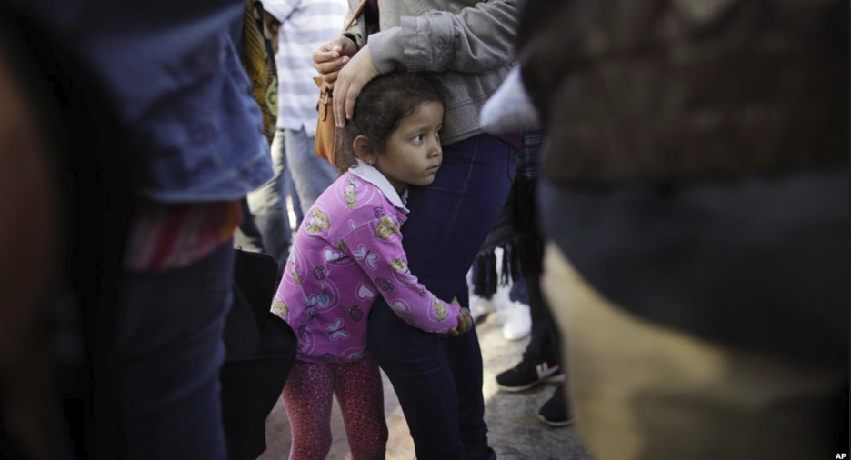
How Were Families Reunified?
Families Reunified in Detention Facilities
Immediate Social Service Provided by On The Ground Catholic and Lutheran Partners
Locations: El Paso, McAllen, Phoenix, San Antonio, and Albuquerque

Slide 10

Existing and Future Needs
Immediate Social Service Needs
  Immediate Shelter, Food, Travel Assistance
Longer Term Social Service Needs
  Child Welfare Checks, School Enrollment Assistance, Medical and Mental Health
Legal Service Needs
  Immigration Services, Family Law Services

Slide 11
Next Steps
POLICY GOAL: Success of Reunited Families’ Case Management Is Vital to Appetite for Alternatives to Detention and Family Case Management
ACTION: Support efforts by Congress to initiate Alternatives to Detention with DHS and Post Release Services and Home Studies with HHS
QUESTIONS: Do you have case specific questions about a client of yours or how to help? Please email familyseparation@usccb.org
EDUCATE: Please check in to Justice for Immigrants, www.justiceforimmigrants.org and Interfaith Immigration Coalition www.interfaithimmigration.org for more updates

Slide 12
Engage with Congress on Family Incarceration & Detention
Hannah Evans
FCNL

Slide 13
Congress Holds the “Purse Strings”
Congress funds the agencies that carry out family separation, detention, and reunification
The deadline for allocating funding for the next fiscal year is September 30
Good governance requires robust oversight and accountability of federal spending
As people of faith, we must speak out when policies and spending misalign with our values

Slide 14
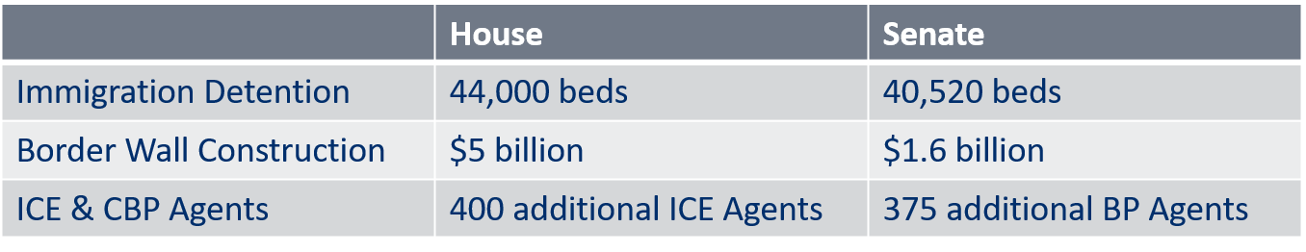
What harmful spending is Congress considering?
The Appropriations Committees have approved these bills, but they have not been brought up for full floor consideration.

Slide 15
Our “Asks” for Congress
Urge the administration to end “zero-tolerance” criminal prosecution of families and asylum seekers for crossing the border.
Reduce funding for immigration detention, deportation, and border militarization.
  This includes rejecting new legislation or spending bills that expands family incarceration.

Slide 16
Our “Asks” for Congress
3. Invest in and direct the administration to utilize community-based alternatives to detention.
The Family Case Management Program (FCMP) which was ended in June 2017 should be restored. This pilot program allowed families to traverse immigration proceedings with community and legal support.

Slide 17
How can you reach your elected officials in August?
Call Congress today. Call 1-866-940-2439 three times to connect with your 2 Senators and 1 Representative.
Visit your member of Congress’ office. Schedule a visit using the IIC Neighbor to Neighbor Visit Toolkit, or drop off materials.

Slide 18
Write a Letter to the Editor or Opinion Editorial.
  Call on your member of Congress by name!
  Share stories about how unchecked enforcement has affected your community or how your community has supported families and individuals in need.
  Find your local newspapers here: act.fcnl.org/lte/lte

Slide 19
Show up at a Town Hall. Look up if your member of Congress is having a town hall at townhallproject.com or by calling their DC office.
  The House will be on recess until September 4.
  The Senate will be on recess August 4-12.

Slide 20
Engage with candidates running for office in your community. Ask:
  Do you support reducing funding for immigrant detention and investing in community-based alternatives to detention?
  If elected, what will you do to advance policies that protect family unity and the dignity of all immigrants, refugees, and migrants?

Slide 21
Stay Engaged Through Sept 30!
Find these resources and more* at:
  interfaithimmigration.org/August2018Toolkit
  bit.ly/EndFamilySeparationToolkit
* Look for the printable PDF that you can leave behind at your member of Congress’ office, town hall, or candidate forum.

Slide 22
Questions?
Please press *6 to unmute yourself if you have a question.

Slide 23
Contact IIC: Jennifer Amuzie
jamuzie@interfaithimmigration.org
202-867-4567

