Slide 1

Prophetic Witness and Nonviolent Direct Action
Monday, April 3rd, 4-5:30 PM ET/
1-2:30 PM PT.*
For the visual portion of the webinar go to: http://join.me/faith4immigration
For audio only call, dial +1.202.602.1295, Access Code: 354-977-836#.

Slide 2
Agenda
Advocacy on Appropriations- Jen Smyers, Church World Service
Update on DREAMer Legislation- Greisa Martinez, United We Dream
Intro to Nonviolent Direct Action – Sr Marie Lucey, Franciscan Action Network
Planning a Prophetic Action – Rev. Francisco Garcia, LA Sanctuary Coalition
Public Demonstrations and Immigrants’ Rights - Paromita Shah, National Immigration Project
May 1st Rise Up Actions- Noel Andersen, Church World Service
Questions & Answers

Slide 3

Advocacy on Appropriations
Jen Smyers, Church World Service

Slide 4
Congressional Update: Appropriations
All government agencies are currently funded by a Continuing Resolution (CR) that expires on April 28
Congress has to pass a Fiscal Year 2017 appropriations bill by April 28
Trump has asked for $3 Billion for a wall, deportations, and detention
Congress is also working on a Fiscal Year 2018 appropriations bill
President Trump has released a “skinny budget” but will likely release a more detailed budget request in May
  Asks for $4.5 Billion for a wall, deportation force & detention centers
  Would eliminate the Emergency Refugee and Migration Assistance account, which allows the State Department to respond to displacement crises overseas in order to prevent regional instability

Slide 5
Congress can stop Trump from building a wall
and increasing detention and deportations
Trump’s budget proposals would cut funding for education, housing, school lunch programs, and poverty-focused international assistance, and spend billions of dollars to dramatically expand immigration enforcement, targeting our undocumented community members, detaining children and separating families.
Congress has “the power of the purse,” which means they can decide whether or not to fund the $7.5 billion that Trump is asking for in fiscal years 2017 and 2018, over and above last year’s funding for immigration enforcement, to begin implementing his plan.
Congress must robustly fund refugee protection through the Office of Refugee Resettlement and Migration and Refugee Assistance accounts

Slide 6
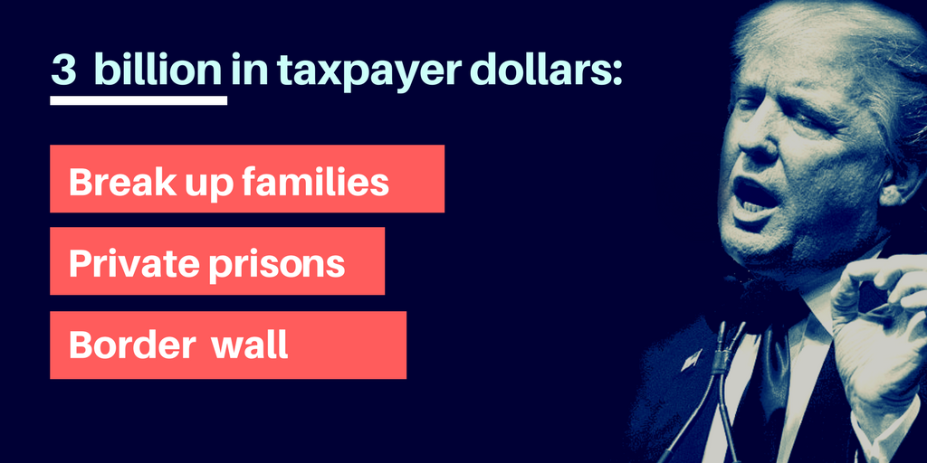

Slide 7
CALL YOUR MEMBER OF CONGRESS TODAY!
Call (866) 961-4293 to connect with your Representative & Senators
“I’m your constituent from [City, State], and I urge you to NOT fund President Trump’s wall, deportation force and detention centers, and instead do everything in your power to rescind his immigration and refugee executive orders. Our tax dollars should be spent alleviating poverty and investing in our future — not rounding up our community members. My community welcomes refugees and immigrants.”

Slide 8

Tweet!
.@HANDLE, show that #AmericaWelcomes. Refuse to fund Trump’s wall, deportation force & detention centers #NoBanNoWallNoRaids
.@HANDLE, stop Trump from targeting refugees and immigrants. Don’t fund his deportation force. #NoBanNoWallNoRaids

Slide 9
United We Dream
#HereToStay
Greisa Martinez Rosas - Advocacy Director

Slide 10
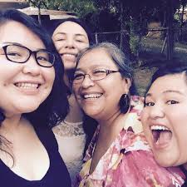
United We Dream
Greisa Martinez Rosas
greisa@unitedwedream.org
unitedwedream.org
@UNITEDWEDREAM.ORG

Slide 11
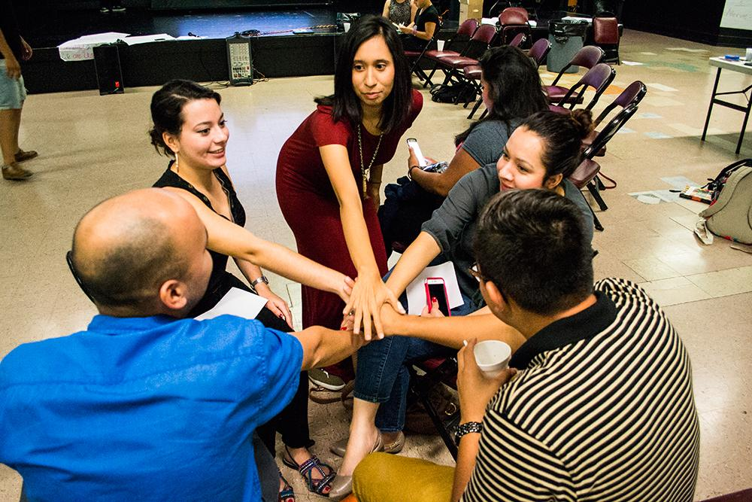
United We Dream
Largest undocumented youth-led network.
55 affiliates around 26 states
300,000 members

Slide 12
UWD 2017
Protecting our community from deportations.
Protect Deferred Action for Childhood Arrivals

Slide 13
Legislative strategies
Defensive
  Sanctuary Cities
  Collaboration with ICE
  Money for deportation
Offensive
  Executive orders
  Immigrant’s reform
  DREAM Introduction

Slide 14
Legislative Strategy

Slide 15
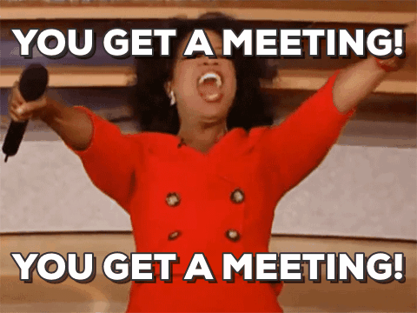
Things you can do to help:
Meet with your member of congress this recess to demand:
Block Trump’s check for mass deportation - No money for raids, detention or the wall.
Permanent protection for undocumented immigrants and undocumented youth.

Slide 16

Go Big & Go Bold
Text “Here to Stay”
to
877-877

Slide 18

Introduction to Nonviolent
Sr. Marie Lucey, Franciscan Action Network

Slide 19
Civil Disobedience
What? Public and nonviolent acts of resistance to structures of authority.
Why? Act of conscience contrary to law to bring about change. Achievement of a greater social good.
When? After legal means of persuasion, advocacy and protest pursued with no effect.

Slide 20
Examples from faith traditions
Book of Exodus: Hebrew midwives defied Pharaoh's order to kill Hebrew males at birth
Jesus healed on the Sabbath, permitted disciples to pick and eat grain on the Sabbath, his whole life nonviolent resistance
Martin Luther King Jr. et al., acts of civil disobedience
CD to protest development of nuclear weapons, e.g. Jesuit Dan Berrigan, Dorothy Day. . .
All claimed God’s law higher than human laws.

Slide 21
Pertinent Quotes
MLK: “One has a moral responsibility to disobey unjust laws.”
Gandhi: “An unjust law is itself a species of violence… should be resisted not by counter-violence but by non violence… breaking the law and submitting to arrest...
Bayard Rustin: “We need in every ...community a group of angelic troublemakers.”

Slide 22
Suggested steps in decision making
Prayer and personal discernment about seriousness of the issue, timing, consequences
Consultation as needed (pastoral, legal, et al.)
Continued prayer and discernment
Decision
Sharing with persons impacted by decision: family, community or other

Slide 23
Planning a Prophetic Action
Rev. Francisco Garcia, LA Sanctuary Coalition

Slide 24

Checklist for Successful Tactics
Does it meet your organizational goals as well as your issue goal?
Is it directed at the decision maker you are trying to move?
Does it put more power behind a specific demand?
Is it outside the Target/ Decision Makers experience to sufficiently agitate to push towards desired outcome?
Is it within the experience of your members and are they comfortable with it?

Slide 25
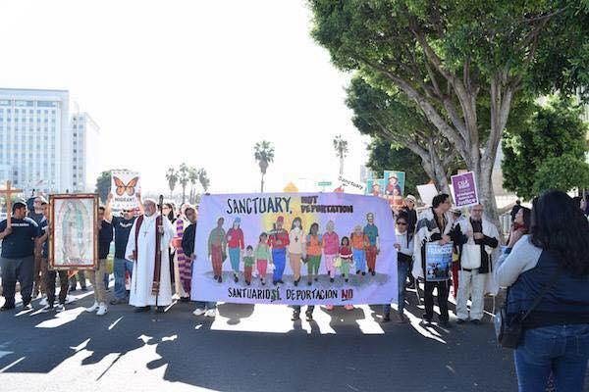
March in Los Angeles 2016

Slide 26
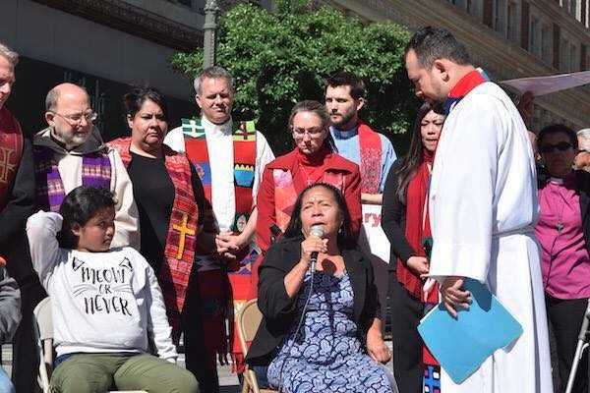
Foot Washing Before Risking Arrest

Slide 27
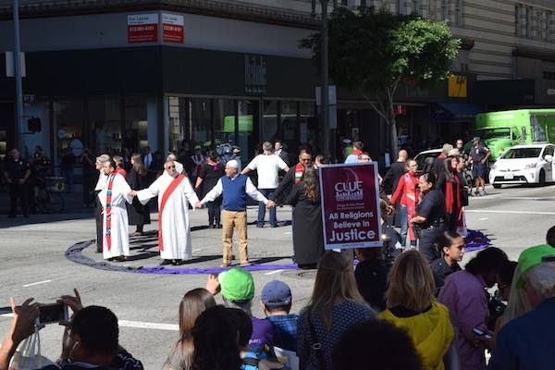
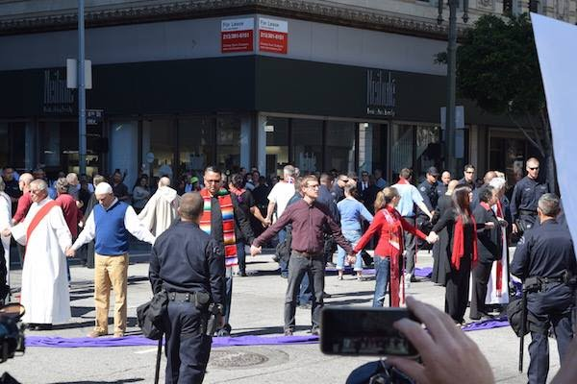
Symbolic formation of prayer circle

Slide 28
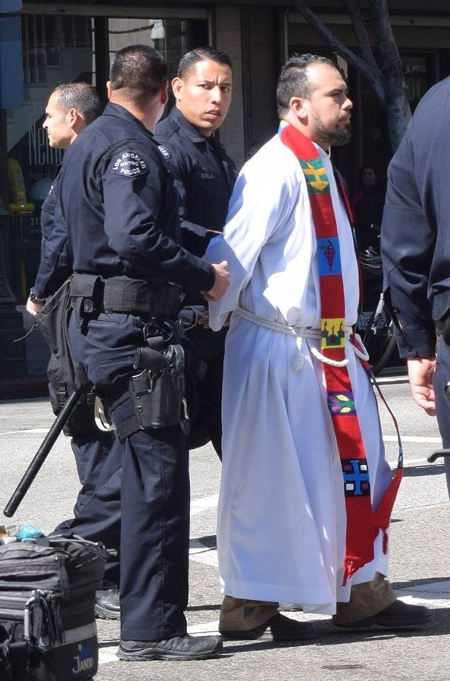
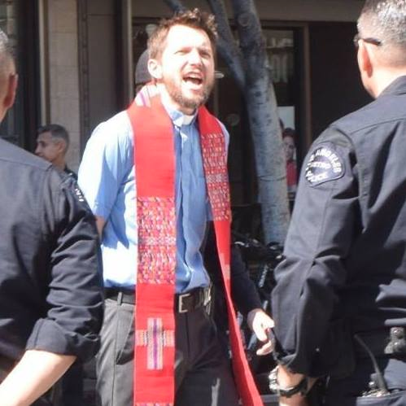
Faith Rooted Civil Disobedience

Slide 29

How to Plan for a Prophetic Action, part 1
For clergy and lay leaders, the action they are invited to be part of is often planned along with a partner organization.
Make sure the action has a component that will lift up the moral and faith voice which is a critical component of impacting the public narrative.
Have ample discussion and dialogue on Civil Disobedience as a spiritual practice.
Make sure that the participant's congregation will support the CD action
Assure that there is sufficient legal support, if there is not, make sure to have your own legal support established

Slide 30
How to Plan a Prophetic Action, part 2
Recruit Early if possible to give volunteers plenty of time to discuss with their organization and/or congregation
Scout the sight of the action ahead of time gathering site-specific information. Make sure the sight is a strategic location to drive the message and meaning this action is meant to convey.
Visible Roles for other leaders such as leading communal prayer or reading a sacred text, lay leaders can help as peace keepers for crowd control are also needed.
Creative Actions that have specific symbolic meaning to the purpose and larger movement is critical in getting the desired message out to the public in an effective way. Think outside the box and do something new.
Religious Vestments are always needed to lift up the visual symbolism and clearly identify faith leaders in the action, stoles, clergy collars and robes should be encouraged in the planning

Slide 31
How to Plan a Prophetic Action, part 3
Negotiations with the police will be very important to establish clear agreements about what type of charge will be given for the action. There are possibilities when you would want to keep the element of surprise and not negotiate beforehand, but there should always be ample legal advice on the charges participants will face.
Security Culture is critical as risking arrest is not a public planning process, and must only be discussed with trusted members who will be participating. The public invitation is for a general event or action while risking arrests should not be disclosed to the public until the moment of execution. This helps create privacy for planning while avoiding possible conspiracy charges for organizers.
Host a training or conference call with leaders committed to the Civil Disobedience ahead of time to answer any questions and go through action details step by step
Be Ready on the day of action with all materials, and details planned out such as having participants bring money if there will be a fine or holding personal items for them
Jail Support when they are released it is great to have a team with a vigil outside of jail, helping people get personal items, food or rides home as they are released

Slide 32
How to Plan a Prophetic Action, part 4
A Communications plan is an essential piece of getting the word out to the public. Write your media release ahead of time. Get quotes from faith leaders in media releases with whom you are collaborating. Utilize this opportunity as a way to build media contacts
Opinion Editorials and Blogs Ask your key participants to write an Opinion Editorial or blog ahead of time about why they felt convicted to participate in a Civil Disobedience action. To ensure this piece happens you may have to ghost write a draft and ask for edits from your leader.
Social Media is a growing means of communication. At the action make sure someone is live tweeting and updating your organizations’ facebook page. Tweeting @(Rep/Sen/President) with the decision makers twitter handle is a great way to do advocacy through social media. Make sure to do social media updates for any blogs, Opinion Editorials or

Slide 33
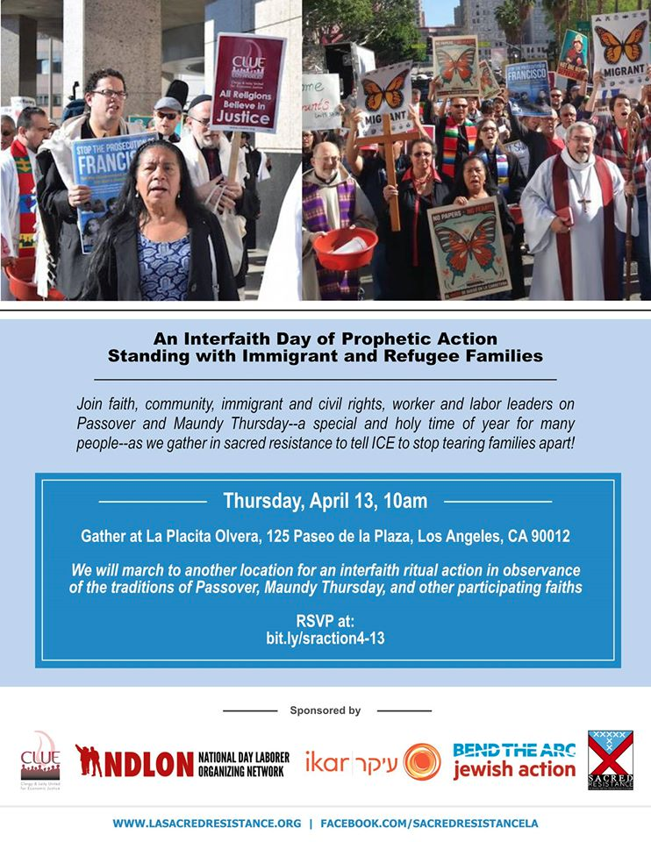

Slide 34
Resources for Further Learning
The above information referenced several organizations below
Pace e Bene – Non-Violent Change 101
http://paceebene.org/nonviolent-change-101/building-nonviolent-world/methods/nonviolent-action-checklist
Beautiful Trouble, A Toolbox for Revolution
http://beautifultrouble.org/introduction/
Midwest Academy Organizing Institute, Training schedule below
http://www.midwestacademy.com/training/organizing-social-change/
Ruckus Society- Training and Action
http://www.ruckus.org/article.php?list=type&type=64

Slide 35

Risk Analysis of
Civil Disobedience
Paromita Shah,
National Immigration Project

Slide 36
Risk Analysis, Step 1
Understand the person’s immigration status and their goals, because only then will you understand the implications of whatever action is being planned:
Goals of person: Arrest or Planning to obey orders of police
Person’s status: deportation order, criminal history, green card, DACA, in-process
How vulnerable is the family
Adult v Minor

Slide 37
Risk Analysis, Step 2
What are the possible offenses: barricade vs. marching, dropping banner, civil rights caravan
Best to consult with public defenders experienced in imm matters (someone who knows how arrest, booking, ICE transfers work)
imm attorneys experienced in deportation defense
NLG chapter might be a good resource (www.nlg.org)

Slide 38
Risk Analysis, Step 3
The threat on the outside:
287g agreement or close police/ICE relationship
Does your jail hold noncitizens for ICE
how does your local ICE office respond to requests for prosecutorial discretion?

Slide 39
Risk Analysis, Step 4
Solidarity Strategy: This will help you figure out what risks you want to take together and the consequences of those choices to the most vulnerable in your group
Identification question: INA 264(e) and risks
Immigrant Worker Freedom Rides:
https://www.youtube.com/watch?v=LOEQtiH4C3M, Minutes 11:30-21:30

Slide 40
Risk Analysis, Step 5
Resources/ response plan :
Don’t only rely on your lawyer
Retaliation for action
Family planning
Political response

Slide 41
Basic Planning
Basic planning: http://www.nationalimmigrationproject.org/tools.html
Get a privacy waiver/G-28 signed for everybody (not necessary to disclose alienage)
Have safety packets prepared for counsel if you have it
Clean up social media;
Disable fingerprint lock on your cell phone
Don’t talk and don’t lie
Legal observers on hand, local NLG chapter

Slide 42
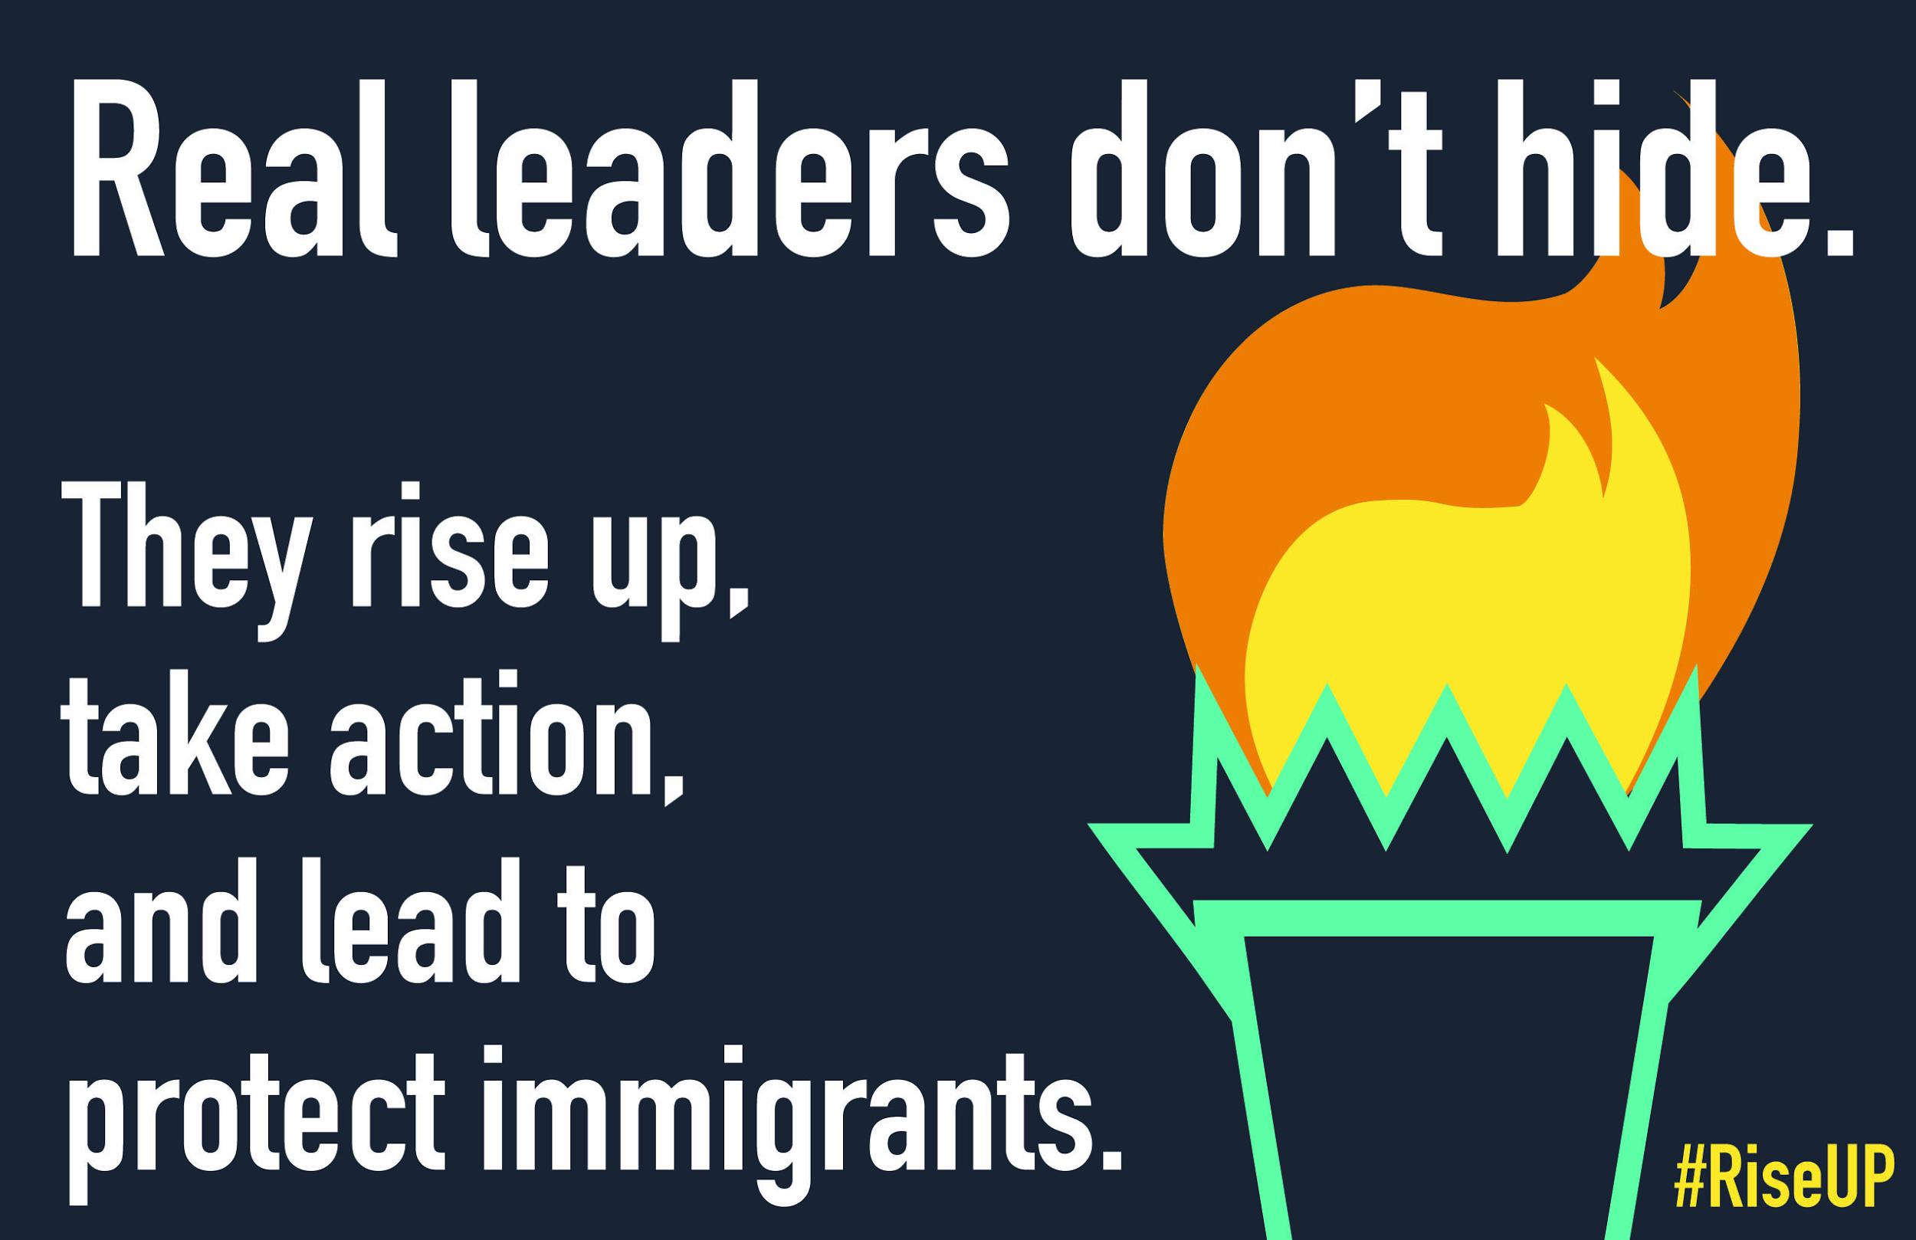
May 1st Rise Up Actions

Slide 43
5 ways faith communities can take part in May 1st actions
1. Be a “Torch Bearer” & Show Up in Solidarity to May 1st Actions and Rallies
2. Call for Economic Justice through strike solidarity & support
3. Forge new relationships between immigrants, refugees, Muslims and faith communities
4. Tell Congress: Thou shalt not steal from the poor to pay for the deportation machine!
5. Let the prophetic voice ring loud!
MORE INFO: https://reformimmigrationforamerica.org/rise-up/

Slide 44
Q&A
If you’ve called in on the phone - you can unmute yourself to ask a question press *6 tell us your name and where you are from before you ask your question!
When you’re finished asking your question press *6 again to mute your line.
You can also type your question in the chat box on the webinar screen.

Slide 45
Thank you!
Thanks for joining the April IIC Grassroots Webinar. Look out for a follow up email with additional resources, a recording of the webinar, and a copy of the powerpoint slides.

