Slide 1
After the Executive Orders: Taking Action at Home to Support Immigrants and Refugees To join the webinar, you will go to http://join.me/faith4immigration and follow the directions for audio and visual. For audio only call, dial +1.202.602.1295, Access Code: 354-977-836#.

Slide 2
Introductions
Rev. Dr. Sharon Stanley-Rea
Refugee & Immigration Ministries
Christian Church (Disciples of Christ)

Slide 3
Agenda
Overview of the Executive Orders
What role does Congress play?
How to set up and conduct in-district congressional visits
Other opportunities to engage in back home
Break out sessions with your regional group
Report back – Questions and Answers

Slide 4
Overview of the Executive Orders
Jen Smyers
Church World Service

Slide 5
Executive Orders
Border Wall
Interior Enforcement
Refugee and Muslim Ban
We urge the administration to immediately rescind all 3 of these Executive Orders
We urge Congress to publicly oppose these Executive Orders and prevent their implementation through legislation and the appropriations process
We urge state and local policy makers to publicly oppose these Executive Orders and affirm welcome for all immigrants and refugees

Slide 6
Border Wall
Use all available federal and state funding to build the border wall (estimated $31.2 billion to construct, plus maintenance)
Mandates 100% operational control of the border, an impossible standard
Increases detention centers and mandatory detention without bond, including for families
Further militarizes border communities
Reduce access to asylum & parole, including for unaccompanied children
Returns asylum seekers to Mexico
Increases use of expedited removal and “operation streamline,” en mass criminal prosecutions for illegal entry / re-entry
Hires 5,000 Customs and Border Protection officials
Mandates reporting of foreign aid to Mexico

Slide 7
Interior Enforcement
Increases raids
Forces local police to serve as immigration enforcement officers or face reductions in federal grant funding
Reinstates the 287(g) program and the Secure Communities Program
Mandates that all legal means are used to remove all undocumented immigrants
Rescinds all priorities so that essentially all undocumented immigrants are enforcement priorities
Hires 10,000 ICE agents
Increases fines and penalties for undocumented immigrants and employers
Sanctions 23 countries that don’t accept deportations
Excludes people who are not U.S. citizens or Lawful Permanent Residents from the privacy act, meaning that their personal information can be subject to availability

Slide 8
Refugee & Muslim Ban
Reduces FY17 refugee admissions from 110,000 to 50,000
Suspends ALL refugee resettlement for 120 days*
Indefinitely suspends Syrian resettlement*
Suspends all entry of people from Syria, Iraq, Iran, Yemen, Libya, Somalia and Sudan for 90 days*
Preferences religious minorities fleeing religious persecution*
Lays the groundwork for more state / local authority over resettlement
* These provisions have been temporarily halted due to court action

Slide 9
More Information on Refugee & Muslim Ban
Flights were initially cancelled for refugees from the 7 nationalities listed, as well as all refugees with flights after February 3rd. Flights are now being rebooked through Feb 17th given the court orders.
After much confusion, it has been announced that Lawful Permanent Residents (LPRs), Special Immigrant Visa (SIV) recipients, and individuals with dual-nationalities should not be impacted by the Executive Order
67,689 refugees have already been approved by DHS and thus will be impacted by any suspension or reduction in the program
Most refugees set to come to the United States are reuniting with family members already here
Many individuals were returned to refugee camps after selling their belongings, giving up their shelter, packing their bags and being told their destination city
This is NOT similar to anything that President Obama did. There was never a pause or ban on Iraqi refugees. Additional security screenings were put in place in 2011 which slowed down the arrival of Iraqi refugees, but they continued to arrive every month.
3,500 religious leaders oppose this Executive Order – see www.interfaithimmigration.org/3500religiousleaderletter/

Slide 10
What YOU Can Do!
Call your national, state and local policy makers: www.rcusa.org/advocate-now/
Tweet @realDonaldTrump & @WhiteHouse and post on whitehouse.gov/contact and Facebook.com/WhiteHouse
Ask your business, health, educator, law enforcement, and faith partners to sign onto these sector-specific letters:
bit.ly/Business4Refugees
bit.ly/Educators4Refugees
bit.ly/LawEnforcement4Refugees
bit.ly/Health4Refugees
bit.ly/FaithLeaders4Refugees
Set up meetings with your national, state & local policy makers! www.interfaithimmigration.org/neighbor

Slide 11
What role does Congress play?
Hannah Evans
Friends Committee on National Legislation

Slide 12
Congress can:
Defend against detrimental proposals codifying or worsening threats to immigrants and refugees.
Withhold funding for the border wall construction and increased enforcement.
Rescind the Executive Orders through legislation.
Pass legislation that protects immigrants and refugees.
Hold the administration accountable for resettling at least 75,000 refugees, as Congress originally funded.

Slide 13
Defeating Detrimental Legislation
There are already proposals in Congress to:
Increase militarization of the border
Reduce and restrict refugee resettlement
Expand mandatory detention for immigrants
Jeopardize community trust policies
Look for more info. for IIC commitments to the 115th Congress at: www.interfaithimmigration.org/neighbor

Slide 14
Rescinding the Executive Orders
There are also bills that would rescind or block the executive orders in different ways. A full run down can be found at:
http://interfaithimmigration.org/eobills

Slide 15
Why connect with your members of Congress?
Your Senators and Representative need to understand that their constituents and people of faith care about welcoming immigrants and refugees in their communities.
Building relationships between people of faith and public officials who make decisions that impact our communities is the most powerful agent of change.

Slide 16
What’s the best way to influence members of Congress?
In-person by:
Setting up an in-district visit
Attending a town hall
Travelling to Washington, D.C.
Phone Calls (second best to in-person!)
Tweets (Monitored actively by communications staff)
Emails (Read by Legislative Staff)
Letters (long delay; security measures = two week delay. Will be scanned electronically)

Slide 17
Set up a Neighbor to Neighbor congressional visit today!
Congress is on recess from February 18 – February 24 for President Day recess. They should hear from you while they are home.
Go to http://interfaithimmigration.org/neighbor to find our toolkit and start brainstorming with your team.

Slide 18
Before your visit
Find a team
Find individuals who are representative of diverse aspects of your community
Do your research
Learn about who represents your community in Congress
Have a plan
Assign roles for the visit
Schedule a meeting by calling the closest office

Slide 19
During your visit
Introduction
Thank you
Share Personal Stories
Delve into specific issue areas/facts
“Ask”
Can we count on you to support positive reforms and defend against proposals that would adversely affect immigrant and refugee communities?
Listen for their response and follow-up questions
Thank you, repeat “ask”
Follow up!
Notes:
How can your conversation be most effective?
Respect
Thanks
Finding common ground
Facts
Personal stories

Slide 20
After your visit
Debrief
Follow up with the member and their office!
Call their Washington D.C. office
Let us know how your visit went so that our staff can help you follow up:
Find the form at http://interfaithimmigration.org/neighbor

Slide 21
Other Opportunities to Engage
Noel Andersen
Church World Service

Slide 22
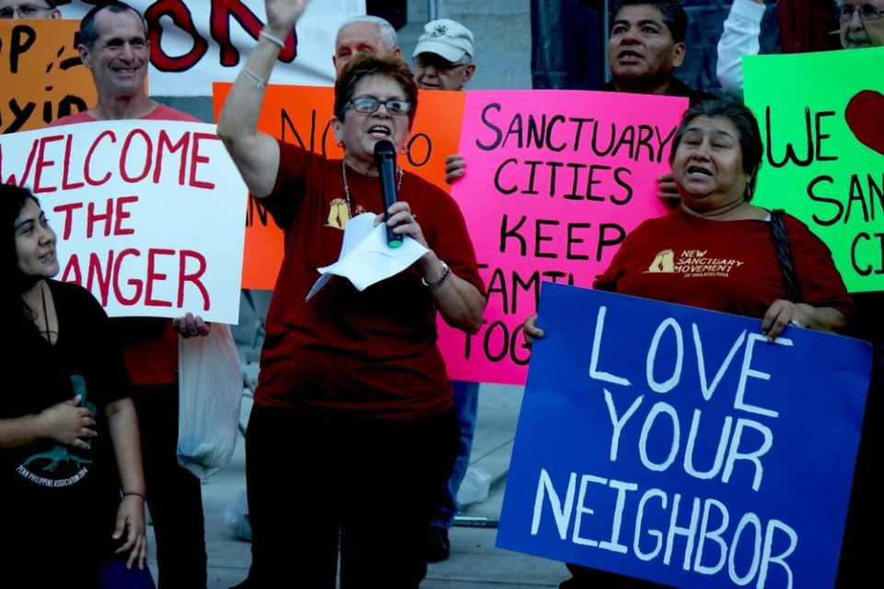
Sanctuary Movement

Slide 23
Sanctuary Movement
A way to resist the increased attack on immigrants and refugees by opening the doors of places of worship as safe places for refuge
From 400 congregations to 800 congregations engaged in the Sanctuary Movement and from 12 coalitions to 18 coalitions
Sing the Pledge to Resist Discrimination and Deportation through the Sanctuary Movement
https://action.groundswell-mvmt.org/petitions/we-pledge-to-resist-deportation-and-discrimination-through-sanctuary
Sign Up to organize a regional training – nandersen@cwsglobal.org
Rapid Response to raids as needed

Slide 24
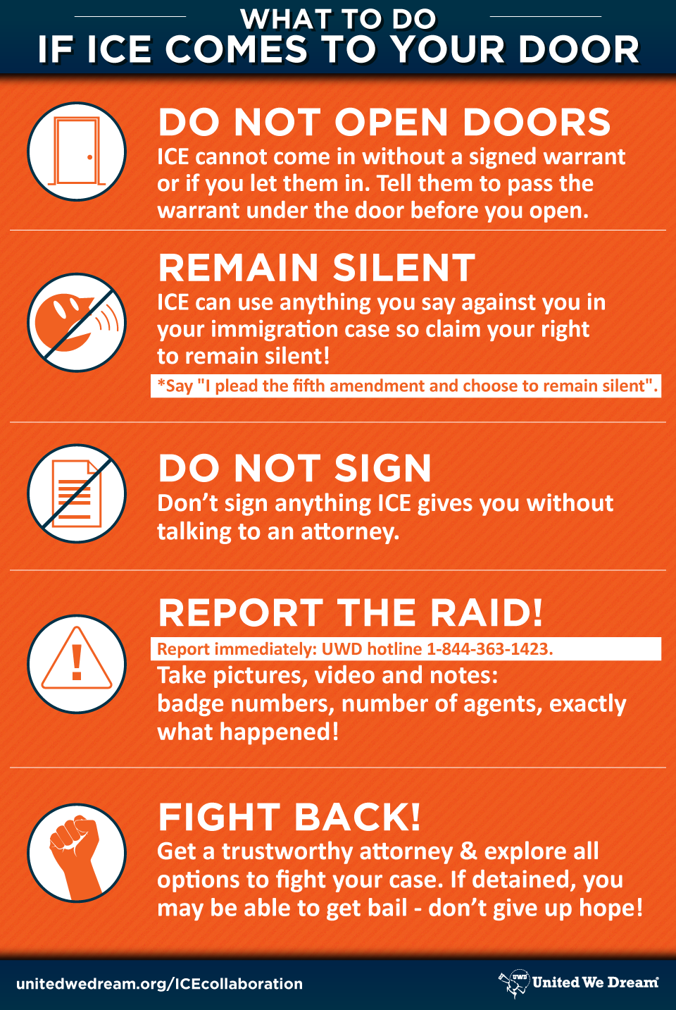

Slide 25
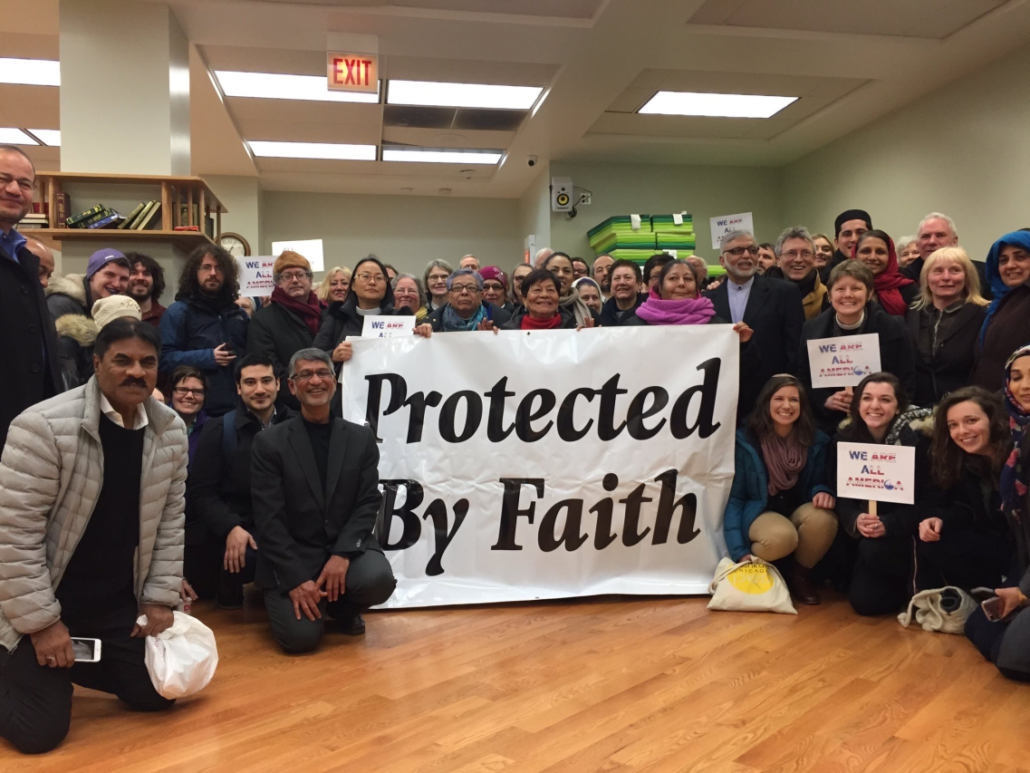
#WeAreAllAmerica
Feb 3rd Solidarity Events with Muslim Communities
Solidarity rallies in 22 states, and 35 cities

Slide 26
#WeAreAllAmerica February22nd
Faith leaders, immigrants’ rights groups, refugee agencies, civic leaders will be rallying for a day of action at their congressional district office on February 22nd Day of Action
IIC Neighbor to neighbor, RCUSA and WeAreAllAmerica visits to district office compliment one another

Slide 27
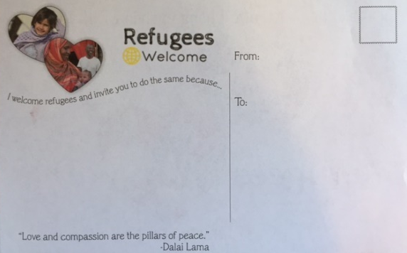
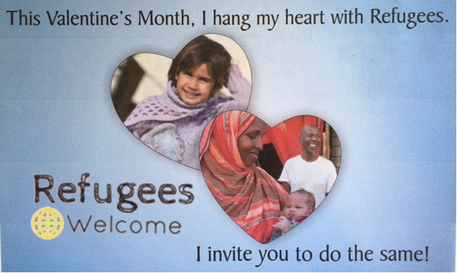
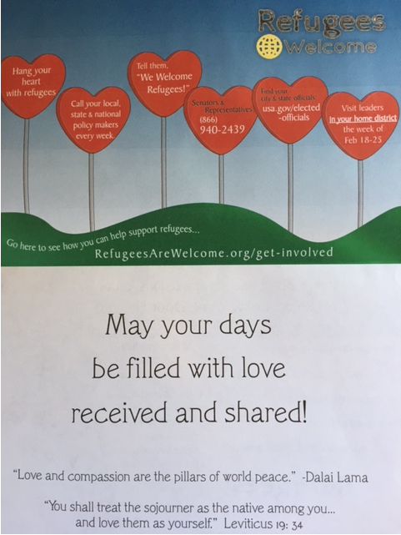
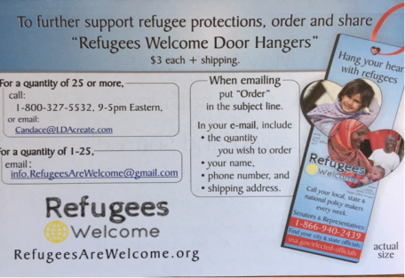
Valentine’s Day Actions
WHAT TO DO FOR V-DAY:
1) SEND REFUGEES WELCOME
POSTCARDS TO LEGISLATORS
2) SEND REFUGEES WELCOME FOLDED CARDS TO YOUR FRIENDS—to encourage their advocacy!
Go to: http://www.refugeesarewelcome.org/welcoming-resources/

Slide 28
Valentine’s Day Actions
CALL CONGRESS WITH LOVE
Call Congress (202-224-3121) to ask your representative to resist the executive orders of this administration.
Action Alerts
http://www.interfaithimmigration.org/recent-legislation/
State by State Action Alerts
http://www.interfaithimmigration.org/state-action-alerts/
WRITE A REVOLUTIONARY LOVE NOTE OR VALENTINES DAY CARD
Write a love letter or make a Valentine and post a picture of it using the hashtag #RevolutionaryLove

Slide 29
Refugee Welcome Dinners V-Day
Refugees Welcome: Valentine’s Day Edition with UNICEF and Purpose
This Valentine’ s Day, let’s move beyond romantic love to share the love of community. Across the country, people will be breaking bread and breaking barriers by hosting dinners between refugees and non-refugees to establish cross-cultural understanding, and friendship.
Hosts and attendees will use food to spark cultural dialogue and share memories -- but the events themselves can very simple. The objective is to share, learn, build community.

Slide 30
Group Break-out Sessions
Kristin Kumpf
United Methodist Church
General Board of Church and Society

Slide 31
Questions for Group Break-Outs
Taking Action - Discuss what action(s) you are inspired to do together across your state during the next month. Could you do a V-day Event and an in-district visit/ action on Feb. 22nd? What event(s) could you do to reach key Senators or Representatives? How can you build energy?
With a Senate target, think about several events scattered throughout the state to show widespread strength if possible.
Organizing People - Who needs to be recruited to join us? What important constituencies are missing and need to be invited? How can they plug in?
Decide who will reach out to which congregations/ organizations/ leaders.
Creating an Action Plan – what are 2 - 3 clear next steps to take action?
Try picking 2 potential dates for an action(s) and 2 potential places. Decide on a process and timeline to pick a date/place for actions, and who will then make the invite to the Member of Congress (try to do this ASAP).
Group Communication and Connection - What will your next steps be after this call? How will you continue to connect and organize yourselves? What are you inviting people to and how will you clearly communicate it?
Decide on 1-2 point people for your state, with everyone committing to email them your contact information and action/ recruitment commitments
Decide on a date for a follow up call and clarify who will be working on what
Decide on your report back and call back in to the main call at 5:30pm!

Slide 32
Call-in to Your State Phone Number
Alabama (515) 604-9341, 611405
California (712) 770-4123, 362698
Colorado (641) 715-0729, 459186
Connecticut (515) 739-1264, 644788
Florida (515) 739-1281, 342742
Georgia (319) 527-9114, 834157
Illinois (515) 604-9362, 300356
Indiana (712) 770-4058, 191080
Iowa (515) 739-1207, 100981
Kansas (319) 527-9157, 417078
Kentucky (515) 739-1265, 405838
Maine (712) 770-4079, 824506
Maryland (515) 739-1250, 484116
Massachus. (515) 604-9359, 725589
Michigan (641) 715-0694, 868230
Minnesota (515) 739-1219, 766897
Missouri (641) 715-0723, 741345
Montana (319) 527-9195, 672151
Nebraska (319) 527-9117, 860363
New Jersey (712) 770-4078, 404937
New Mexico (712) 770-4078, 460333
New York (641) 715-0608, 624493
North Carolina (641) 715-0671, 312246
North Dakota (641) 715-0733, 526727
Ohio (515) 739-1265, 405053
Oklahoma (515) 739-1296, 312775
Oregon (712) 770-4106, 762305
Pennsylvania (515) 739-1238, 884556
South Carolina (712) 770-4145, 924387
South Dakota (515) 604-9324, 363186
Texas (712) 770-4128, 843760
Vermont (712) 770-4082, 891902
Virginia (515) 604-9387, 142421
Washington (319) 527-9134, 972778
Wisconsin (515) 604-9320, 991941
Wyoming (641) 715-0701, 546078

Slide 33
At 5:30 p.m., dial and plug back in to the call with all Webinar participants!
To join the webinar, go to: http://join.me/faith4immigration and follow the directions for audio and visual.
For audio only call (and for best audio reception), also dial +1.202.602.1295, Access Code: 354-977-836#.

