Slide 1
Interfaithimmigration.org
Welcome to the IIC’s Webinar on
Senate vote on S.744: The Border Security, Economic Opportunity, and Immigration Modernization Act
and next steps!
Monday, July 1st, 2013
Call and Webinar will begin at 4:00 p.m. EST
For audio, please dial 805-399-1000 and enter access code 104402. The audio and visual portions are NOT linked. You must dial this number to hear the audio portion of the webinar.

Slide 2
AGENDA
4:00 Welcome & overview – Sharon Stanley-Rea (Disciples of Christ)
4:05- What Just Happened In the Senate…and What’s Next? – Jen Smyers, Associate Director, Immigration & Refugee Policy, CWS
4:15- Flying In to Advocate in DC…and How I’m Advocating Now After Coming Home- Lyndon Rogers from Texas, and Kels Phelps from Montana, participants from last week’s DC Faith Fly In for Immigration
4:25- Focusing On the House: Effective Talking Points for Visits with Representatives- Mary Small, Associate Director for Policy, Jesuit Refugee Service/USA and Ryan Murphy, Policy Specialist, Sisters of Mercy
4:40 - Q &A
4:55 – Conclude

Slide 3
Resources
National Immigration Law Center Analysis: http://nilc.org/irsenate2013.html
IIC Member Statements on passage: www.interfaithimmigration.org/2013/06/27/coalition-members-respond-to-senate-passage-of-the-immigration-reform-bill
Top 5 Things Senate Bill Accomplishes: www.americanprogress.org

Slide 4
What Happened in the Senate?
S.744 was introduced in the Senate on April 16, 2013
301 amendments were proposed by Senate Judiciary Committee members. A third of those were considered and 92 were incorporated into the bill by voice vote. We were able to soundly defeat the worst anti-immigrant amendments in committee and gain modest improvements.
On May 21, S.744 passed 13-5 out of the Senate Judiciary Committee.
S.744 then went to the full Senate floor for further amendments and debate. More than 600 amendments were introduced, but only a few were actually voted on. The most controversial and disappointing amendment was the Corker/Hoeven amendment (see next slide).
The Corker/Hoeven amendment was added to the base bill and included in a substitute bill, which passed the Senate.
The bill passed the senate with a robust bi-partisan vote of 68 to 32.

Slide 5
Corker / Hoeven Amendment
Requires:
20,000 additional agents along the southern border
$4.5 billion in specific technology and equipment along the southern border
A total of 700 miles of fencing completed along the southern border
The amendment also included language restating what was already in the bill and/or standard practice regarding:
Mandatory electronic visa entry/exit system employment-verification
Apprehensions and removal of visa overstayers
Preventing individuals from getting Social Security credits that they paid into the system using a different social security number
Prohibiting states from using Temporary Assistance for Needy Families (TANF) dollars to provide benefits to people in RPI status.
Some positives:
Mandates DHS place rescue beacons along southern border to prevent migrant deaths
Mandates DHS report and monitor migrant deaths in the desert
Waives the 3 and 10-year bars for immigrants eligible for backlog reduction
Establishes Youth Jobs Fund for low-income youth and young people with disabilities.

Slide 6
Senate Vote Count S.744
The full Senate approved the bill with a robust bipartisan vote of 68-32, with all democrats voting yes and the following republicans:
Lamar Alexander (TN) Kelly Ayotte (NH) Jeffrey Chiesa (NJ) Susan Collins (ME) Bob Corker (TN) Jeff Flake (AZ) Lindsey Graham (SC) Orrin Hatch (UT) Dean Heller (NV) John Hoeven (ND) Mark Kirk (IL) John McCain (AZ) Lisa Murkowski (AK) Marco Rubio (FL)

Slide 7
What’s next?
Now that the Senate has passed immigration reform, we must now get the House to do the same. In order for immigration reform to be signed into law, the House must pass a bill or multiple bills, then the House and Senate must conference the bills together, and then the President must sign a final compromise bill into law.
Especially given the bipartisan support in the Senate, we should all be putting pressure on our members of the House of Representatives to champion immigration reform.
There are a few ways this could happen in the House, which we will cover later on in this call.

Slide 8
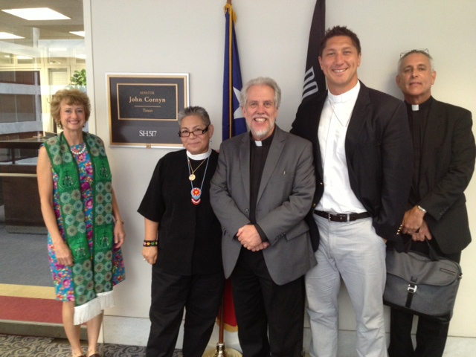
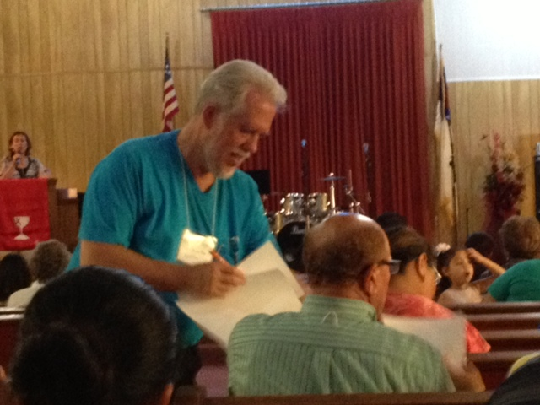
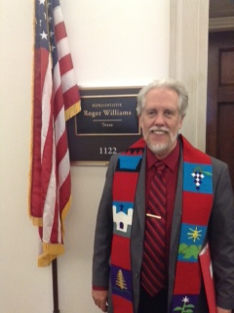
DC Faith Fly in

Slide 9
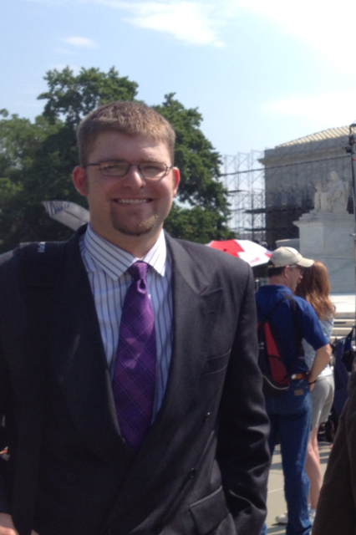
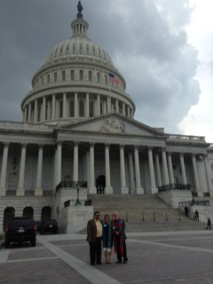
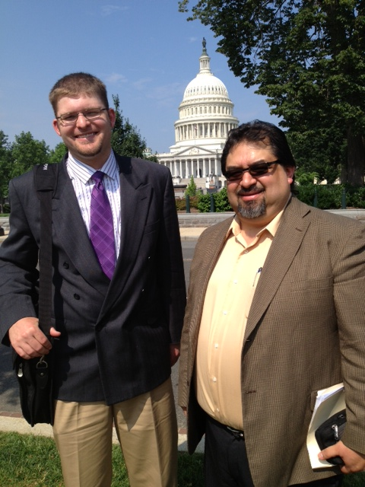
DC Faith Fly in

Slide 10
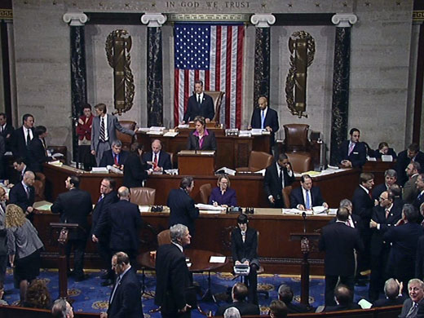
Possible Routes Forward
Piecemeal bills from the House Judiciary Committee
SAFE Act (Enforcement)
Agricultural Guestworkers
E-Verify
High-skilled Immigrants
Others?
Comprehensive bill from the Group of 7
Either way, ultimately conferenced with S.744

Slide 11
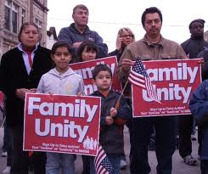
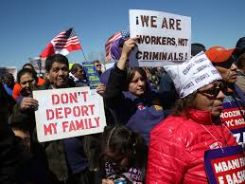
Family Unity
Families are the fabric of strong communities and economies. Immigration reform must facilitate family reunification. Family unity spurs integration, as families provide strong foundations for learning English, purchasing a home, pursuing employment, starting a business, preparing children for school, and contributing to communities.
We are not opposed to increases in employment-based visas, but they should not come at the expense of family visas - it's not a zero-sum game. People want to join their families through legal channels, but with exorbitant wait times as long as 24 years, have no real options to do so. To fix the immigration system, we need to recognize the God-given desire to be with one's family.

Slide 12
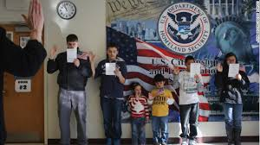
Path to Citizenship
A concern for the well-being of families and children—who really need stability to in order to thrive—is also why we support a pathway to citizenship.
People of faith strongly support a pathway to full citizenship for our undocumented community members. Such a pathway should be clear, timely, direct, and accessible.
Proposals that would create a pathway to legal status but stop short of citizenship are not consistent with our who we strive to be as a nation, nor with how people of faith live out the scriptural commandment 'to welcome the stranger'.

Slide 13
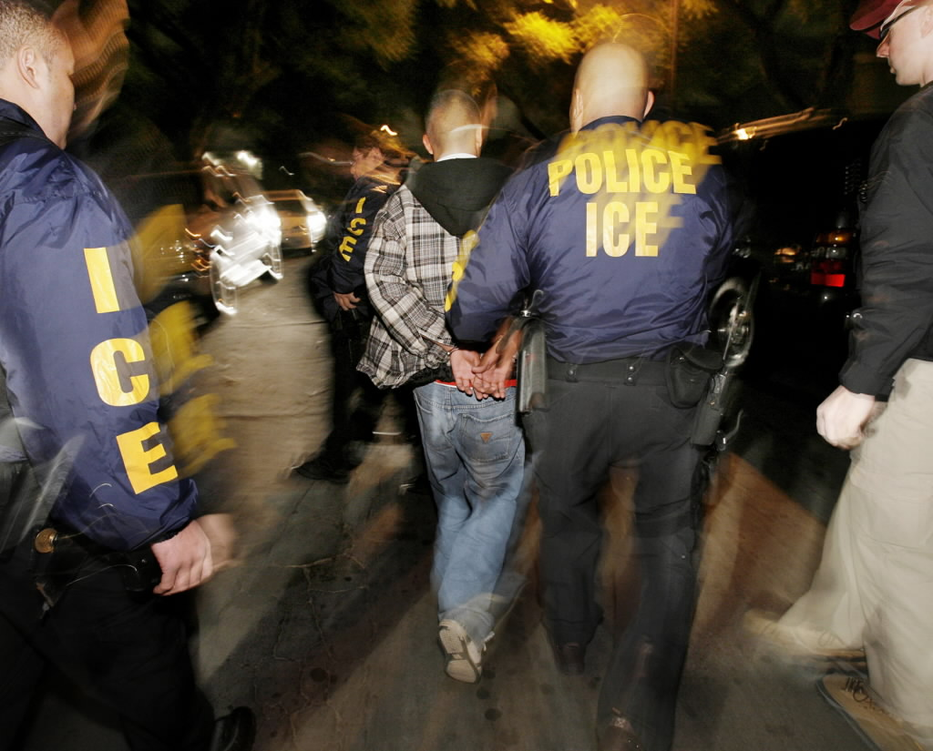
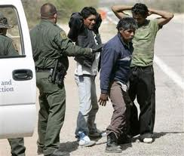
Align the enforcement of immigration laws with humanitarian values
We must adopt a comprehensive perspective on mitigating future unauthorized immigration.
While all laws need to be enforced to be effective, the way that we enforce our laws must have integrity and reflect the best of American values.
We can implement common-sense and humane guidelines, such as those concerning unsafe deportations in the middle of the night, standards for detention conditions, alternatives and release, and access to due process for those trying to navigate our complex immigration system.

Slide 14
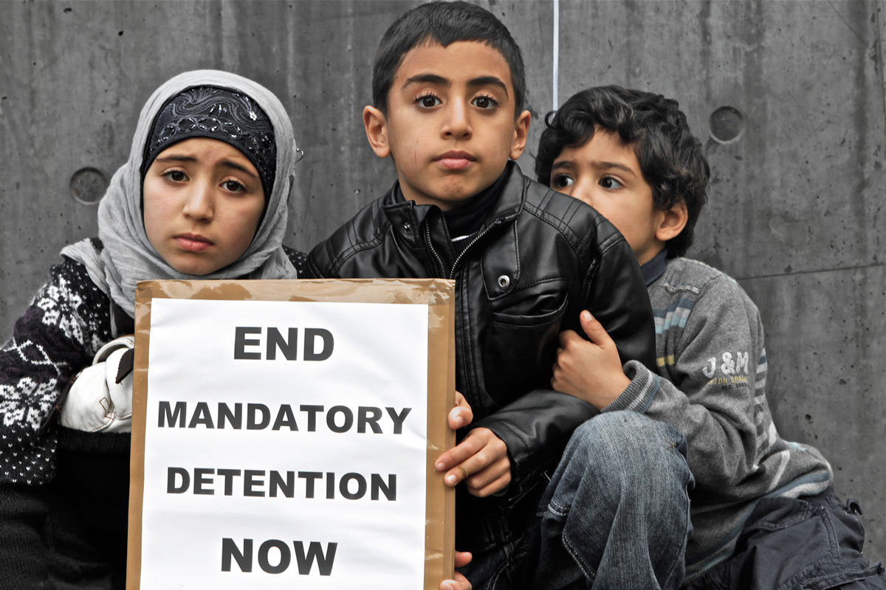
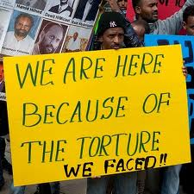
Protecting Refugee and Asylum Seekers
Across the country, faith communities welcome refugees and help them build their new lives. We support proposals that would enhance the U.S.'s rich history of welcoming individuals fleeing persecution based on their race, religion, nationality, political opinion, or membership in a particular social group. We oppose proposals that would negatively impact vulnerable populations' access to life-saving protection.
Recommendations of discussion topic
Delink the conflation of Boston Bombings and refugees
Praise the positive aspects in the Senate Bill – removing the one year filing deadline

Slide 15
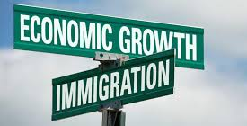
Economic Impact
Immigration reform will decrease the deficit by over $100 billion dollars in the first ten years and by nearly $700 billion over the following ten years, and increase GDP by 3.3 percent. [CBO, 6/13 CBO, 6/24] In 20 years, state tax revenue would increase by $748 billion and the earnings of all Americans would be increased by .5 percent.

Slide 16
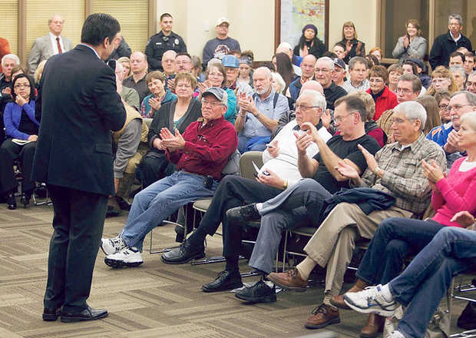
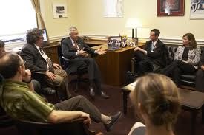
What we should do with all this info!
Take action by scheduling in-district visits with your representative, attending town hall meetings, hosting events and writing op-eds/letters to the editor in your local newspaper.
Check with the IIC and member organizations for talking points and materials for your local advocacy.
Let’s work together – please share any reports from your in-district activities.
Do your homework and know your representative’s priorities. Preparedness goes a long way.

Slide 17
IIC Contacts by organization
African American Ministers in Action: Leslie Malachi, lmalachi@pfaw.org
American Jewish Committee: Chelsea Hanson, hansonc@ajc.org
Bread for the World Institute: Andrew Wainer, awainer@bread.org
Church World Service: Jen Smyers, jsmyers@churchworldservice.org
Disciples of Christ: Sharon Stanley-Rea, sstanley@dhm.disciples.org
Episcopal Church: Katie Conway, kconway@episcopalchurch.org
Franciscan Action Network: Marie Lucey, lucey@franciscanaction.org
Friends Committee on National Legislation: Ruth Flower, flower@fcnl.org
Hebrew Immigrant Aid Society: Liza Lieberman, liza.lieberman@hias.org
Interfaith Worker Justice: Michael Livingston, mlivingston@iwj.org
Irish Apostolate USA: Geri Garvey, administrator@usairish.org
Islamic Information Center: Hajar Hosseini, hosseini@islamicinformationcenter.org
Jesuit Conference, Shaina Aber, saber@jesuit.org
Jesuit Refugee Service/USA, Mary Small, msmall@jesuit.org
Jewish Council for Public Affairs: Elyssa Koidin, ekoidin@thejcpa.org
Lutheran Immigration and Refugee Service: Nora Skelly, nskelly@lirs.org
Mennonite Central Committee: Tammy Alexander, talexander@mcc.org
Muslim Public Affairs Council: Hoda Elshishtawy, hoda@mpac.org
Sisters of the Good Shepherd: Larry Couch, lclobbyist@gsadvocacy.org
NETWORK: Sr. Mary Ellen Lacy, D.C., melacy@networklobby.org
Pax Christi: Scott Wright, scott@tassc.org
PICO: Heibi Thompson, hthompson@piconetwork.org
Presbyterian Church, USA: Melissa Gee, melissa.davis@pcusa.org
Sisters of Mercy of the Americas: Ryan Murphy, rmurphy@sistersofmercy.org
Sojourners: Ivone Guillen, iguillen@sojo.net
Union for Reform Judaism: Sarah Krinsky, skrinsky@rac.org
Unitarian Universalist Association: Jen Toth, JToth@uua.org
United Church of Christ: Rev. Mari Castellanos, castellm@ucc.org
United Methodist Church: Bill Mefford, bmefford@umc-gbcs.org
UNITED SIHKS: Harpreet Singh, harpreet.singh@unitedsikhs.org
U.S. Conference of Catholic Bishops: Kevin Appleby, kappleby@usccb.org
World Relief: Jenny Yang, jgyang@worldrelief.org

