Slide 1
Interfaithimmigration.org
Welcome to the IIC’s Webinar on
Fast Action for Immigration Reform Initiative
Monday, July 29TH, 2013
Call and Webinar will begin at 4:00 p.m. EST
For audio, please dial 805-399-1000 and enter access code 104402. The audio and visual portions are NOT linked. You must dial this number to hear the audio portion of the webinar.

Slide 2
AGENDA
4:00 Moderator: Welcome & overview – Rev. Sharon Stanley-Rea, Director of Refugee & Immigration Ministries, Disciples of Christ
4:05- House legislative update – Jen Smyers, Associate Director, Immigration & Refugee Policy, CWS
4:15- Fast Action for Immigration Reform Initiative- Eli McCarthy PhD, Director of Justice and Peace, Conference of Major Superiors of Men
4:25- Spiritually of Fasting and Prayer - Ann Scholz, SSND, PhD, Associate Director for Social Mission, Leadership Conference of Women Religious
4:30- Why I Pray and Fast – Peter Pedemonti, Director, New Sanctuary Movement of Philadelphia
4:35- Signs of Change Photo Contest- Sidney Traynham, Media Associate for Immigration Reform, Church World Service
4:40- Q &A
4:55 - Conclude

Slide 3
Resources
Fast Action for Immigration Reform website- www.fastaction.us
Sign-up page: Commit to Pray, Fast, and Advocate- http://fastaction.us/commit-register/
IIC neighbor-to-neighbor visits to your Congressmen in their Home Districts- http://www.interfaithimmigration.org/wp-content/uploads/2013/01/IIC_NEIGHBOR_to_NEIGHBOR_Toolkit_01.pdf
August 2013 Congressional Recess Toolkit- http://www.interfaithimmigration.org/wp-content/uploads/2013/03/Interfaith-Immigration-Coalition-August-Recess-Toolkit.pdf
Prayer Vigils for Family Unity Toolkit- http://www.interfaithimmigration.org/wp-content/uploads/2013/01/IIC_Prayer_Vigil_Toolkit_01.18.13.pdf

Slide 4
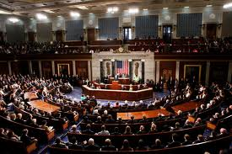
What’s Happening in the House?
Now is a critical time to enact immigration reform. The Senate has passed bipartisan legislation that, while not perfect, would reunite millions of families and create a pathway to citizenship for undocumented, aspiring Americans. Now, all eyes are on the House of Representatives.
If the House does not pass some form of immigration reform, then the Senate bill cannot move forward. If the House passes a bill, even if it is very different from the Senate bill, those two bills can then go to a "conference committee" so that a compromise bill can then be passed by both the House and Senate and finally become law!

Slide 5
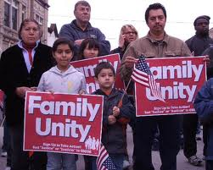
What’s Happening in the House?
It is still unclear how the House will move forward on immigration reform, so we need to send a strong signal to our Representatives that their constituents want to see them support immigration reform that reunites families and creates a path to citizenship.
We also need all of our Representatives to urge their colleagues in House Leadership positions - Speaker Boehner, Majority Leader Cantor, Representative Goodlatte and others - to give us a vote on citizenship!

Slide 6
What’s Happening in the House?
So far, the Homeland Security Committee has approved one bill on border enforcement, and the Judiciary Committee has approved four bills on high skilled visas, employment-verification, agricultural workers and interior enforcement. None would create a path to citizenship.
That interior enforcement bill, the SAFE Act, would make Arizona's anti-immigrant SB 1070 the law for the entire country, encouraging racial profiling and forcing local police to act as immigration officials – which reduces community safety because people will be afraid to report crimes for fear of deportation.
The SAFE Act would also criminalize churches and others who help people who are undocumented and would drastically expand immigrant detention and negatively impact vulnerable refugees. We need to say NO to the SAFE act. It is not the reform we need - we need real reform that will create a path to citizenship and reunite families.

Slide 7
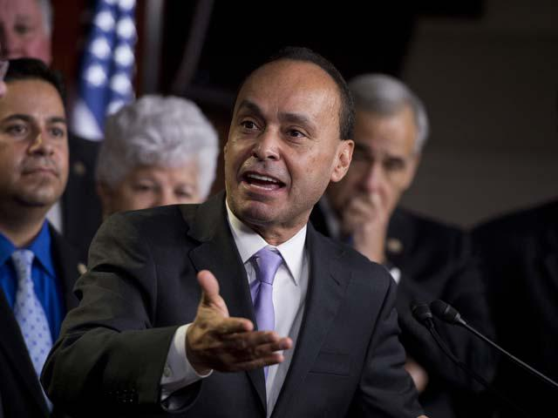
What’s Happening in the House?
Also, 7 House members - Democrats and Republicans - are working together to draft a bill that will likely include a path to citizenship, but we still do not know what this looks like yet. This "House Gang of 7" also need to hear from all Representatives that they want them to introduce their bill - immigration reform can’t wait!
The House is not treating the issue of immigration reform with the urgency it needs to. We need to make sure our Representatives hear us loud and clear, that their constituents want a vote on citizenship!

Slide 8
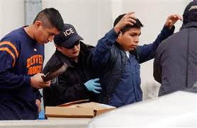
Fast Action for Immigration Reform Initiative
How do we raise the level of concern, engage our communities, and grow in the virtues of solidarity and hospitality? We are at a point where we have to escalate our efforts, expose the injustice, and engage the heart of our country. We are convinced that what we need now is a “compassion surge.”
Invitation to Fast, Pray, and Advocate for
40 Days: Sept. 9- Oct. 18
1. Fast: enter more fully into the suffering
multiple ways to fast
2. Pray: regularly engage relationship with God
Resources available: common prayer, interfaith prayers, weekly intentions
3. Share Experiences and Invite others to Join
Share with others and online at www.fastaction.us
Invite family, friends, religious leaders, etc.

Slide 9
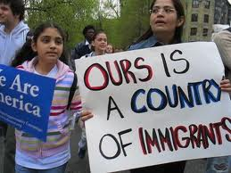
Fast Action for Immigration Reform Initiative
4. Share Commitment with Immigrant Sisters and Brothers
Spend time with, build friendships,
accompany
On the website: share stories of immigrant
peoples or resources on immigration
5. Share Experience and Message with Congress and the Media
Visit Congressional Office with local immigrants
Resources available: talking points, prayer vigils, media communications
6. Celebrate and Give Thanks
Full description of the Fast Action Initiative is available at www.fastaction.us
Sign up for Fast Action on this website!

Slide 10
Prayer and Spiritual Fasting
Prayer and Fasting are Common
to Many Faith Traditions
Faith Leaders have often
Fasted in the Face of
Suffering, Violence, or Injustice

Slide 11
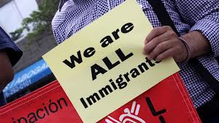
Prayer and Spiritual Fasting
Prayer and Fasting can be an Act of Solidarity
Stand with those Subjected to Injustice
Take on the Suffering of Our Community
Expose the Injustice
Prayer and Fasting can Transform
Our Own Hearts
Heart of Our Community

Slide 12
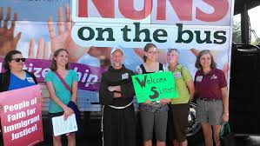
Prayer and Spiritual Fasting
A Spiritual Fast . . .
Abstaining from something in order to focus fully
On Prayer
Needs of the Community
Action
People of Faith Can Fast from Anything

Slide 13
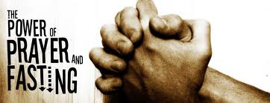
Why I pray and Fast
www.fastaction.us

Slide 14
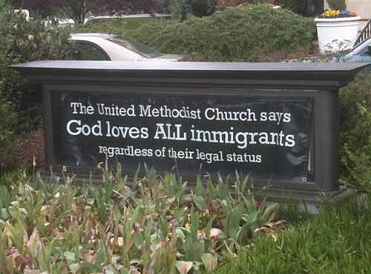
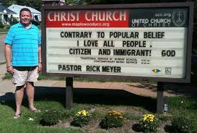
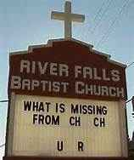
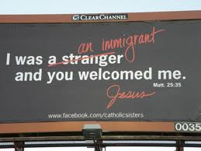
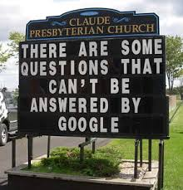
#SignsofChange August Photo Contest

Slide 15
How to join #SignsofChange August Photo Contest
Put together the best creative minds in your congregation – come up with a message supporting immigration reform for your community
Show the message on your congregation’s sign
Take a picture of the sign and email it to signs@interfaithimmigration.org
Look for your picture on the IIC Facebook Page
Get your friends to vote by Sharing, Liking, Tweeting, or Pinning your photo!
Tweet votes with the hash tag #SignsofChange

Slide 16
#SignsofChange Photo Contest!
The congregation with the most votes by the end of August wins two free flights for two congregation members for the next interfaith advocacy fly-in day

Slide 17
IIC Contacts by organization
African American Ministers in Action: Leslie Malachi, lmalachi@pfaw.org
American Jewish Committee: Chelsea Hanson, hansonc@ajc.org
Bread for the World Institute: Andrew Wainer, awainer@bread.org
Church World Service: Jen Smyers, jsmyers@churchworldservice.org
Conference of Major Superiors of Men: Eli McCarthy emccarthy@cmsm.org
Disciples of Christ: Sharon Stanley-Rea, sstanley@dhm.disciples.org
Episcopal Church: Katie Conway, kconway@episcopalchurch.org
Franciscan Action Network: Marie Lucey, lucey@franciscanaction.org
Friends Committee on National Legislation: Ruth Flower, flower@fcnl.org
Hebrew Immigrant Aid Society: Liza Lieberman, liza.lieberman@hias.org
Interfaith Worker Justice: Michael Livingston, mlivingston@iwj.org
Irish Apostolate USA: Geri Garvey, administrator@usairish.org
Islamic Information Center: Hajar Hosseini, hosseini@islamicinformationcenter.org
Jesuit Conference, Shaina Aber, saber@jesuit.org
Jesuit Refugee Service/USA, Mary Small, msmall@jesuit.org
Jewish Council for Public Affairs: Elyssa Koidin, ekoidin@thejcpa.org
Lutheran Immigration and Refugee Service: Nora Skelly, nskelly@lirs.org
Mennonite Central Committee: Tammy Alexander, talexander@mcc.org
Muslim Public Affairs Council: Hoda Elshishtawy, hoda@mpac.org
Sisters of the Good Shepherd: Larry Couch, lclobbyist@gsadvocacy.org
NETWORK: Sr. Mary Ellen Lacy, D.C., melacy@networklobby.org
Pax Christi: Scott Wright, scott@tassc.org
PICO: Dan Gordon, Director of Policy, dwhitman@piconetwork.org
Presbyterian Church, USA: Melissa Gee, melissa.davis@pcusa.org
Sisters of Mercy of the Americas: Ryan Murphy, rmurphy@sistersofmercy.org
Sojourners: Ivone Guillen, Immigration Associate iguillen@sojo.net
Union for Reform Judaism: Sarah Krinsky, skrinsky@rac.org
Unitarian Universalist Association: Jen Toth, JToth@uua.org
United Church of Christ: Rev. Mari Castellanos, castellm@ucc.org
United Methodist Church: Bill Mefford, bmefford@umc-gbcs.org
UNITED SIHKS: Harpreet Singh, harpreet.singh@unitedsikhs.org
U.S. Conference of Catholic Bishops: Kevin Appleby, kappleby@usccb.org
World Relief: Jenny Yang, jgyang@worldrelief.org

