Slide 1
interfaithimmigration.org
Welcome to the IIC Webinar:
Prophetic Witness and Civil Disobedience in the Struggle for Immigrants’ rights
January 13th, 2013
Call and Webinar will begin at 4:00 p.m. EST
For audio, please dial 805-399-1000
and enter access code 104402
* The audio and visual portions are NOT linked. You must dial
this number to hear the audio portion of the webinar.

Slide 2
AGENDA
4:00 PM- Welcome & overview
Moderator: Rev. Noel Andersen, Grassroots Coordinator for Immigrants’ Rights Church World Service
4:05 PM– Announcements and Upcoming Activities
4:10 PM - Policy and Legislative update
Shaina Aber is Policy Director for the U.S. Jesuit Conference Secretary for Social and International Ministries
4:15 PM- History and Purpose of Civil Disobedience
Sr. Marie Lucey, Franciscan Action Network
4:25– Recent Civil Disobedience Actions on Immigration
Rev. Dr. Sharon Stanley- Rea, Refugee & Immigration Ministries Christian Church (Disciples of Christ
Rev. Debbie Lee, Interfaith Immigrants' Rights Coalition/ Clergy and Laity United for Economic Justice- CA,
Maryada Vallet, No More Deaths
4:45 – Campaign Strategy and Civil Disobedience
Rev. Noel Andersen, Grassroots Coordinator for Immigrants’ Rights Church World Service
4:40- How to Plan a Civil Disobedience
Rev. Debbie Lee, Interfaith Immigrants' Rights Coalition/ Clergy and Laity United for Economic Justice- CA
Next Steps, Questions and Discussion

Slide 3
Announcements and Upcoming Activities
Fast For Families: A Call for Immigration Reform and Citizenship
The Fast Continues with Local Actions beginning Jan. 29th
Bus tour launches in Los Angeles Feb. 24th - April 9th ending in Washington DC
Faith Leaders Getting Ready for CD on Not1More Deportations in Mid-February
Lent and Passover Activities Integrating Immigration
Ash Wednesday Services March 5th
Sunrise Services April 20th
Passover April 14-22

Slide 4
Policy and Legislative Updates
House Bills
SAFE Act (Interior Enforcement) HR 2278 passed HJC 6/18
Ag Act (farmworkers) HR 1773 passed HJC 6/19
Legal Workforce Act (E-Verify) HR 1772 passed HJC 6/26
SKILLS Visa Act (High-tech workers) HR 2131 passed HJC 6/27
Border Security Results Act HR 1417 passed HHSC 5/15
CIR ASAP (Grijalva, Vela)HR 3163 introduced 9/20
Protect Family Values at the Border HR 3130 introduced 9/18
Help Separated Families HR 2604 introduced 6/28
BS, EO and IM Act HR 15 Introduced 10/2
?

Slide 5
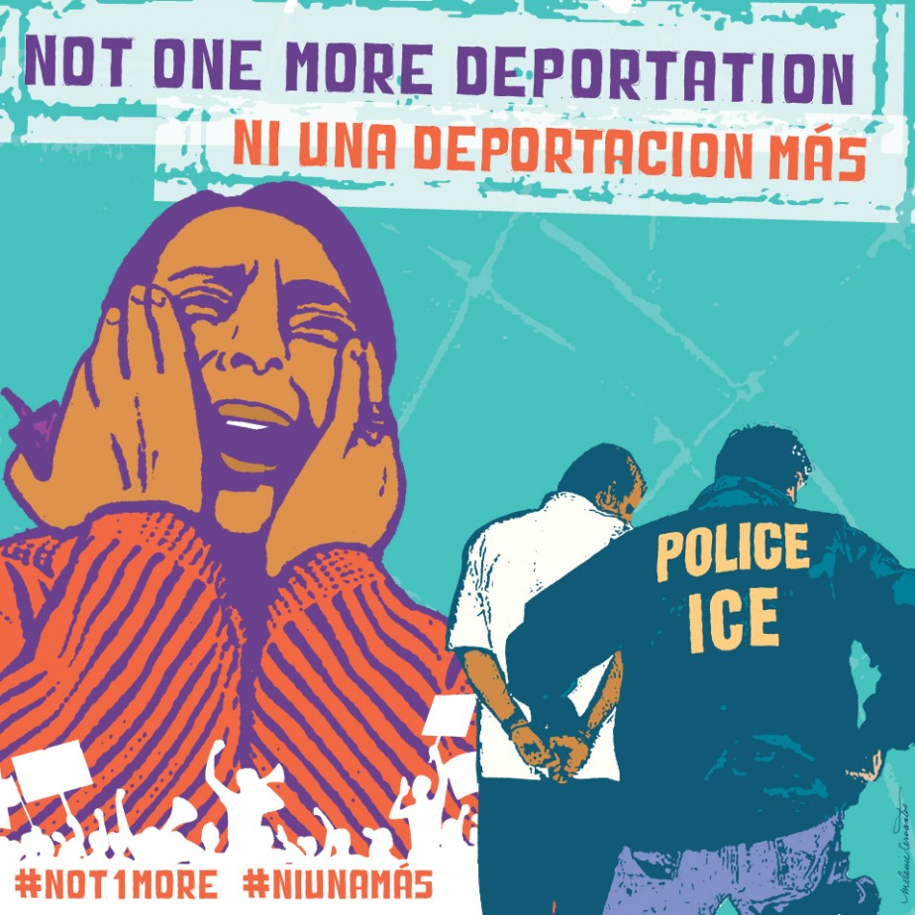
Policy and Legislative Updates
Administrative Updates
Obama Administration quickly approaching marker of 2 Million Deportations
Continued Not1More Deportation Campaign to expand the Deferred Action for Childhood Arrival for all eligible undocumented people
Safer more accountable and humane immigration enforcement policies, such as no late night deportations.

Slide 6
Question and Answer / Discussion
Questions on Policy or Legislative Timeline?

Slide 7
History and Purpose of Civil Disobedience
CIVIL DISOBEDIENCE
What? Why? When?
Public and nonviolent acts of resistance to structures of authority. Act of conscience contrary to law to bring about change.
Achievement of a greater social good.
After legal means of persuasion, advocacy and protest pursued with no effect.

Slide 8
History and Purpose of Civil Disobedience
Examples from faith traditions
Book of Exodus: Hebrew midwives defied Pharoah’s order to kill Hebrew males at birth
Jesus healed on the Sabbath, permitted disciples to pick and eat grain on the Sabbath, his whole life nonviolent resistance
Martin Luther King Jr. et al., acts of civil disobedience
CD to protest development of nuclear weapons, e.g. Jesuit Dan Berrigan, Dorothy Day. . .
All claimed God’s law higher than human laws

Slide 9
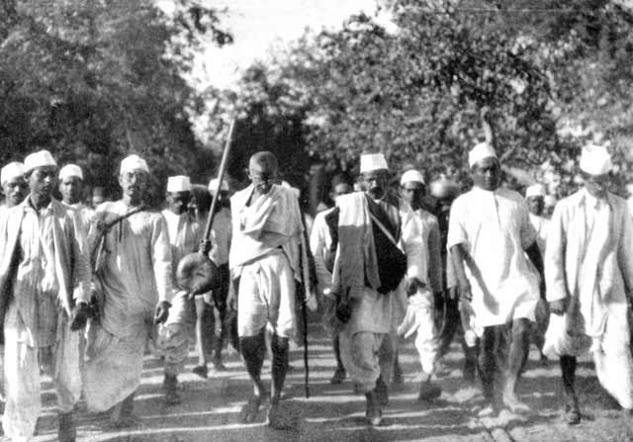
History and Purpose of Civil Disobedience
Quotes
Rev. Dr. Martin Luther King: “One has a moral responsibility to disobey unjust laws.”
Ghandi: “An unjust law is itself a species of violence. . . should be resisted not by counter-violence but by nonviolence. . .breaking the law and submitting to arrest. ..
Bayard Rustin: “We need in every ..community a group of angelic troublemakers.”

Slide 10
Question and Answer / Discussion
Questions on the history and purpose of Civil Disobedience?
Where do you think Civil Disobedience fits in with our faith tradition?

Slide 11
Many Perspectives in Coalition Work
As we begin to engage discussion on Civil Disobedience as an effective tactic within a campaign, its important to note that it may be a controversial subject
Always keep a respectful and open attitude to many perspectives on CD in the process of finding what best fits your organization, congregation or coalition
In doing work within a coalition, find ways to build consensus, to work through differences, or support sub-groups who may move forward without coalition branding
Disclaimer: The Interfaith Immigration Coalition has a broad network, wherein some groups may not support initiatives of Civil Disobedience, while others would actively support such tactics

Slide 12
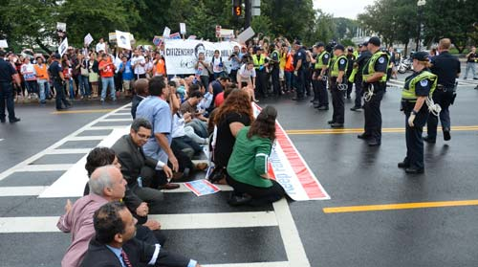
Recent Actions:
DC Leaders Block the Street
Increasing pressure on key members
Civil Disobedience Blocking a street near U.S. Capitol, last August

Slide 13
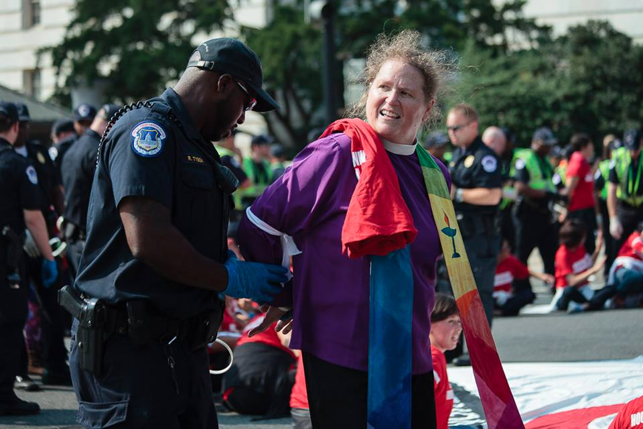
Recent Actions:
We Belong Together
We Belong Together largest Women’s Civil Disobedience in recent history with over 100 women lifting up the struggle of immigrant women and mothers
6 faith leaders join the action

Slide 14
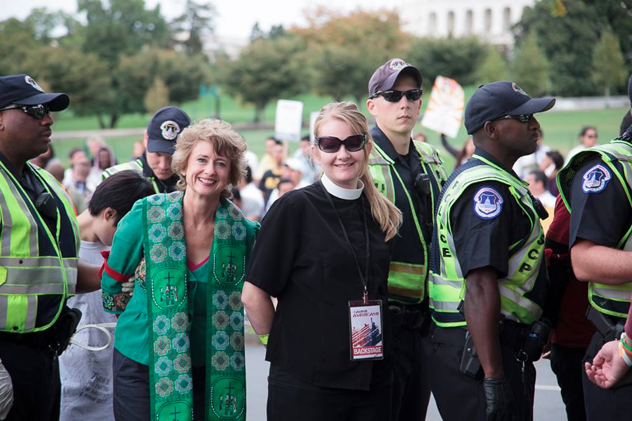
Recent Civil Disobedience
October 8th Day of Dignity and Respect in Washington DC Over 200 people arrested including more 10 dedicated faith leaders
Photo:
Rev. Sharon Stanley-Rea , Director, Refugee & Immigration Ministries
Christian Church (Disciples of Christ)
Rev. Allison Harrington Southside Presbyterian Church

Slide 15
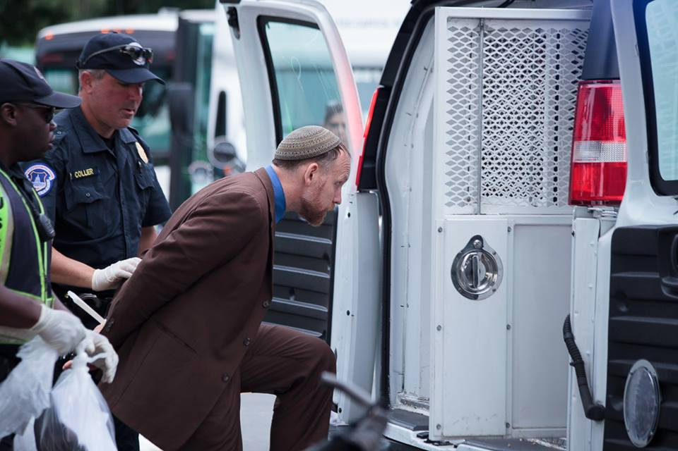
Recent Civil Disobedience
October 8th Day of Dignity and Respect in Washington DC Over 200 people arrested including more 10 dedicated faith leaders
Photo:
Rabbi Jason Kimelman-Block Deputy Director of Bend the Arc Jewish Action,

Slide 16
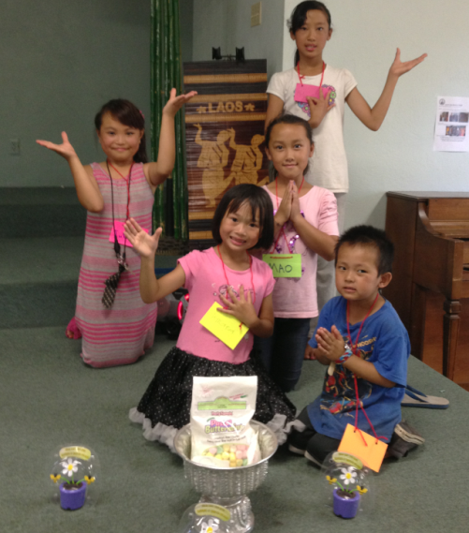
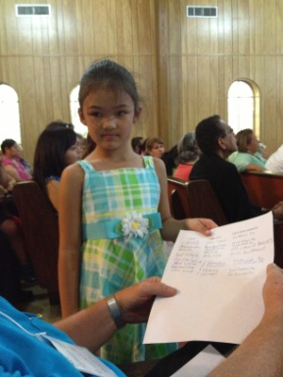
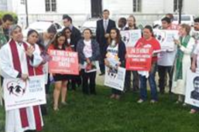
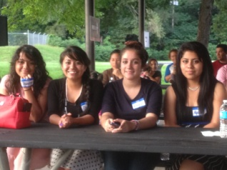
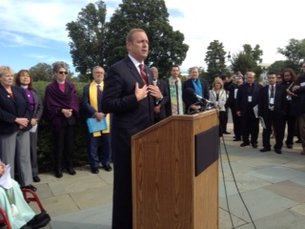
Personal Reflections:
Sharon’s “Top 10 Learnings” from a CD Experience
1. Remember WHO has “brought you”
--Whose stories will you hold near?
--What of your own life will you recall?
2. Honor HISTORY
Choose your TIMING carefully—What path has prepared for NOW?
In the unceasing ebb and flow of justice and oppression we must all dig channels as best we may, that at the propitious moment somewhat of the swelling tide may be conducted to the barren places of life.”
Jane Addams (1860-1935)

Slide 17
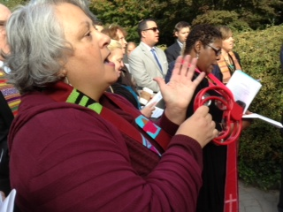
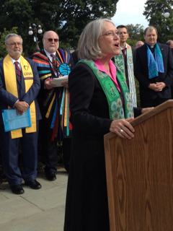
Personal Reflections:
Sharon’s “Top 10 Learnings” from a CD Experience
4. TALK with your “close folks”
--boss/es and work structures
--family members
--key colleagues
5. Carry in your FAITH
Sacred texts are often by and about exiles and written for
communities in exile. ex. Exodus 2:1-10’s political wisdom
from an oppressed family
Research & practice LOGISTICS –Remember ID, required money, plan to store
belongings, eat ahead, don’t forget to plan for a ride home!
7. Anticipate “VALLEYS PROP UP the mountains”
“You can’t really understand a mountain system without understanding the valleys on which it stands….or the immigrants who plant the vegetables and pick the lettuce.” The Changing Shape of Church History, 2002.
Justo Gonzalez in The Changing Shape of Church History.

Slide 18
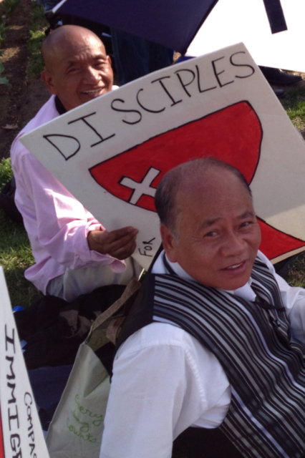
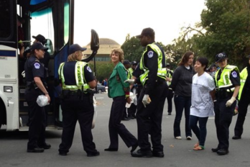
Personal Reflections:
Sharon’s “Top 10 Learnings” from a CD Experience
8. Prep your RESPONSES ahead to help build your movement
--Just after, you will likely be exhausted
--Recruit ahead for those who might assist with media
during and following
--Share your participation ahead of the event with key
partners, so they’ll be expecting to hear your report
9. Surround yourself with SUPPORTERS
“A leader is someone who does not lead out front. But, they are a leader together with the community, from the middle.”
John Bosavanh, Laotian New American Leader
Pray and BUILD RELATIONSHIPS throughout
--You may never have this much time without
your phone again! Enjoy it! Prayer requires
no access to possessions or technology.
--CD forms a tight community bond!

Slide 19
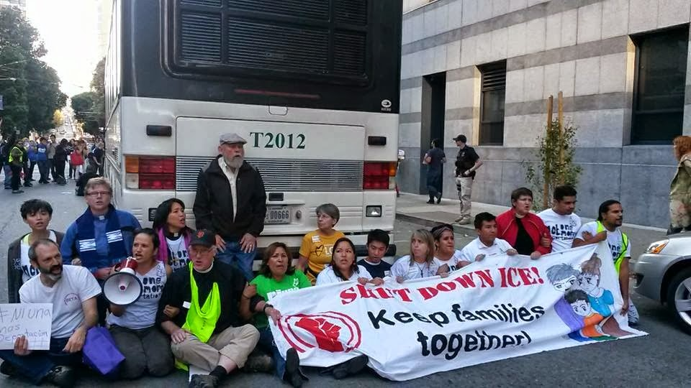
Recent Civil Disobedience
October 17th
Growing Momentum to Stop the Deportations: Actions in San Francisco & Arizona
Seven religious leaders from various denominations accompanied 10 undocumented young people and other allies, using their bodies to stop a bus full of shackled immigrant detainees.

Slide 20
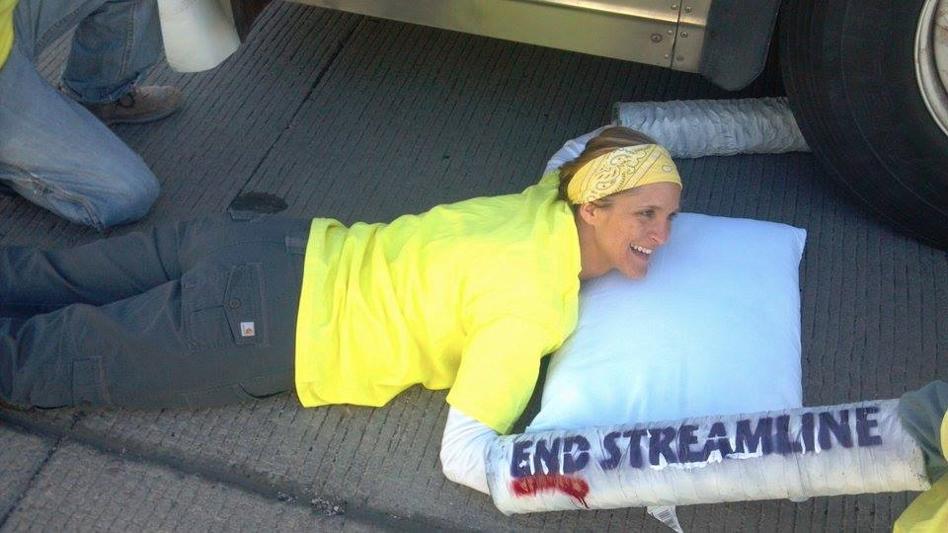
Recent Civil Disobedience
October 11th , 12 immigrants rights activists locked themselves to the wheels of two deportation buses headed to Operation Streamline at a federal court to stop the proceedings.
The protest is part of the #Not1More Deportation campaign calling on the President to use his authority to keep families together and provide immediate relief from deportations

Slide 21
Campaign Strategy
Tactics, activities and actions are rarely effective in helping you meet your goals, unless they are part of a larger strategy
Making your own strategy chart mapping out the following is critical:
Goals- Concrete Desired Outcomes: Short term, Medium-term, Long-term
Organizational Considerations: Capacity, staff, budget, organizational goals
Constituents: How are you building your base, recruitment, allies, opponents
Target: Decision maker you can get you what you want
Tactics: Actions and activities, rally, march, petition, media etc…

Slide 22
Question and Answer / Discussion
Questions on for speakers about their participation in CD.
Are there other actions you were part of that you would like to lift up?

Slide 23
Campaign Strategy and CD
Every tactic you employ, especially Civil Disobedience, should be integrated to your larger and broader campaign strategy
A Civil Disobedience is not a means to itself, it is not effective, unless it will help you reach your campaign goals as part of continued escalation of your strategy

Slide 24
Campaign Strategy and CD
What is the strategic goal (i.e., who are we trying to influence, and what do we want them to do)?
What is the political objective? Will a CD increase pressure on the decision maker?
Where are you on your campaign, have you escalated to the point of CD?
What is the message? How does this event communicate its goals and principles before, during, and after the event?

Slide 25
Checklist for Successful Tactics
Does it meet your organizational goals as well as your issue goal?
Is it directed at the decision maker you are trying to move?
Does it put more power behind a specific demand?
Is it outside the Target/ Decision Makers experience to sufficiently agitate to push towards desired outcome?
Is it within the experience of your members and are they comfortable with it?

Slide 26
Checklist for Successful Tactics
Visible roles are available for those who don’t choose to participate in CD.
The CD demonstrates power to the decision maker
It has effective symbolism and draws on religious tradition or the values/ ethical principles of religious background of participants.
It will strengthen recruitment in the future not hinder further involvement
It will play well with the media and can build your social media.

Slide 27
Question and Answer / Discussion
Share your strategy for a local key decision maker.
Do you think Civil Disobedience would be appropriate in your local strategy?

Slide 28
How to Plan a Civil Disobedience
For clergy and lay leaders, the action they are invited to be part of is often planned by a partner organization.
Make sure the action has a component that will lift up the moral and faith voice
Have ample discussion and dialogue on Civil Disobedience as a spiritual practice.
Make sure that the participant's congregation will support the CD action
Assure that there is legal support, if there is not, make sure to have your own legal support established

Slide 29
How to Plan a Civil Disobedience
Recruit Early if possible to give volunteers plenty of time to discuss with their organization and/or congregation
Scout the sight of the action ahead of time gathering site-specific information. Make sure the sight is a strategic location to drive the message and meaning this action is meant to convey.
Visible Roles for other leaders such as leading communal prayer or reading a sacred text, lay leaders can help as peace keepers for crowd control are also needed.
Creative Actions that have specific symbolic meaning to the purpose and larger movement is critical in getting the desired message out to the public in an effective way. Think outside the box and do something new.
Religious Vestments are always needed to lift up the visual symbolism and clearly identify faith leaders in the action, stoles, clergy collars and robes should be encouraged in the planning

Slide 30
How to Plan a Civil Disobedience
Negotiations with the police will be very important to establish clear agreements about what type of charge will be given for the action. There are possibilities when you would want to keep the element of surprise and not negotiate beforehand, but there should always be ample legal advice on the charges participants will face.
Security Culture is critical as often CD is not a public planning process, and must only be discussed with trusted members who will be participating. Often the public invitation is for a general activity or action and the CD is not disclosed to the public until the moment of execution.
Host a training or conference call with leaders committed to the Civil Disobedience ahead of time to answer any questions and go through action details step by step
Be Ready on the day of action with all materials, and details planned out such as having participants bring money if there will be a fine or holding personal items for them
Jail Support when they are released it is great to have a team with a vigil outside of jail, helping people get personal items, food or rides home as they are released

Slide 31
How to Plan a Civil Disobedience
A Communications plan is an essential piece of getting the word out to the public. Write your media release ahead of time. Get quotes from faith leaders in partner organizations’ media releases with whom you are collaborating. Utilize this opportunity as a way to build media contacts
Opinion Editorials and Blogs Ask your key participants to write an Opinion Editorial or blog ahead of time about why they felt convicted to participate in a Civil Disobedience action. To ensure this piece happens you may have to ghost write a draft and ask for edits from your leader.
Social Media is a growing means of communication. At the action make sure someone is live tweeting and updating your organizations’ facebook page. Tweeting @(Rep/Sen/President) with the decision makers twitter handle is a great way to do advocacy through social media. Make sure to do social media updates for any blogs, Opinion Editorials or

Slide 32
Resources for Further Learning
The above information referenced several organizations below
Pace e Bene – Non-Violent Change 101
http://paceebene.org/nonviolent-change-101/building-nonviolent-world/methods/nonviolent-action-checklist
Beautiful Trouble, A Toolbox for Revolution
http://beautifultrouble.org/introduction/
Midwest Academy Organizing Institute, Training schedule below
http://www.midwestacademy.com/training/organizing-social-change/
Ruckus Society- Training and Action
http://www.ruckus.org/article.php?list=type&type=64

Slide 33
Question and Answer / Discussion
What questions or comments do you have on planning a Civil Disobedience?
Are you interested in planning a Civil Disobedience in the near future? If so what might that loook like

Slide 34
Vision for 2014
Continued Pressure on Key Decision Makers, neighbor to neighbor meetings, vigils, fasting, posadas
Fast4Families: A Call for Immigration Reform and Citizenship will continue to move in the field starting Jan. 29th with Bus Tour Launch Feb. 24th
Get Ready to escalate in 2014 with creative new tactics that could include Civil Disobedience
Continued pressure on the Obama Administration to expand DACA with deferred action for all eligible undocumented people
Civic Engagement: The power of the vote will impact decision makers on immigration, get ready to help register voters and turn out votes

Slide 35
IIC Contacts by organization
African American Ministers in Action: Leslie Malachi, lmalachi@pfaw.org
American Baptist Home Mission Societies of the American Baptist Churches, USA:
Aundreia Alexander,
Audreia.Alexander@abhms.org
American Friends Service Committee: Lia Lindsey, llindsey@afsc.org
American Jewish Committee: Chelsea Hanson, hansonc@ajc.org
Bread for the World Institute: Andrew Wainer, awainer@bread.org
Church World Service: Jen Smyers, jsmyers@churchworldservice.org
Columban Center for Advocacy and Outreach: Chloe Schwabe,
cschwabe@columban.org
Conference of Major Superiors of Men: Eli McCarthy emccarthy@cmsm.org
Daughters of Charity: Mary Ellen Lacey, Maryellen.lacy@doc.org
Disciples of Christ: Sharon Stanley-Rea, sstanley@dhm.disciples.org
Episcopal Church: Katie Conway, kconway@episcopalchurch.org
Franciscan Action Network: Marie Lucey, lucey@franciscanaction.org
Friends Committee on National Legislation: Ruth Flower, flower@fcnl.org
HIAS: Liza Lieberman, liza.lieberman@hias.org
Interfaith Worker Justice: Michael Livingston, mlivingston@iwj.org
Irish Apostolate USA: Geri Garvey, administrator@usairish.org
Islamic Information Center: Hajar Hosseini, hosseini@islamicinformationcenter.org
Jesuit Refugee Service/USA, Mary Small, msmall@jesuit.org
Jewish Council for Public Affairs: Elyssa Koidin, ekoidin@thejcpa.org
Leadership Conference of Women Religious: Ann Scholz, SSND ascholz@lcwr.org
Lutheran Immigration and Refugee Service: Nora Skelly, nskelly@lirs.org
Maryknoll Office for Global Concerns: Judy Coode, jcoode@maryknoll.org
Mennonite Central Committee: Tammy Alexander, talexander@mcc.org
Muslim Public Affairs Council: Hoda Elshishtawy, hoda@mpac.org
Sisters of the Good Shepherd: Larry Couch, lclobbyist@gsadvocacy.org
NETWORK: Ashley Wilson, awilson@networklobby.org
Pax Christi: Scott Wright, scott@tassc.org
PICO: Dan Gordon, dwhitman@piconetwork.org
Presbyterian Church, USA: Melissa Gee, melissa.davis@pcusa.org
Sisters of Mercy of the Americas: Ryan Murphy, rmurphy@sistersofmercy.org
Sojourners: Ivone Guillen, iguillen@sojo.net
3P Human Security: Tom Brenneman, brenneman_tom@hotmail.com
T’ruah: The Rabbinic Call for Human Rights, Rabbi Rachel Kahn-Troster
rkahntroster@truah.org
Union for Reform Judaism: Sarah Krinsky, skrinsky@rac.org
Unitarian Universalist Association: Jen Toth, JToth@uua.org
United Church of Christ: Rev. Mari Castellanos, castellm@ucc.org
United Methodist Church: Bill Mefford, bmefford@umc-gbcs.org
UNITED SIHKS: Harpreet Singh, harpreet.singh@unitedsikhs.org
U.S. Conference of Catholic Bishops: Kevin Appleby, kappleby@usccb.org
U.S. Jesuit Conference, Shaina Aber, saber@jesuit.org
World Relief: Jenny Yang, JGYang@wr.org

